Slide 1
WITHOUT WARNING
Sudden Cardiac Arrest is not rare, 7,000 youth die each year from SCA and most times it occurs Without Warning. Having an emergency response plan in place is the key to increasing the chance of survival from this silent killer.
In this webinar you will learn:
  How to recognize warning signs that are often missed or mistaken for other conditions.
  How to incorporate drills for the #1 killer on school campuses in your emergency plans.
  How to ensure all students and employees are prepared in an SCA emergency.

Slide 2

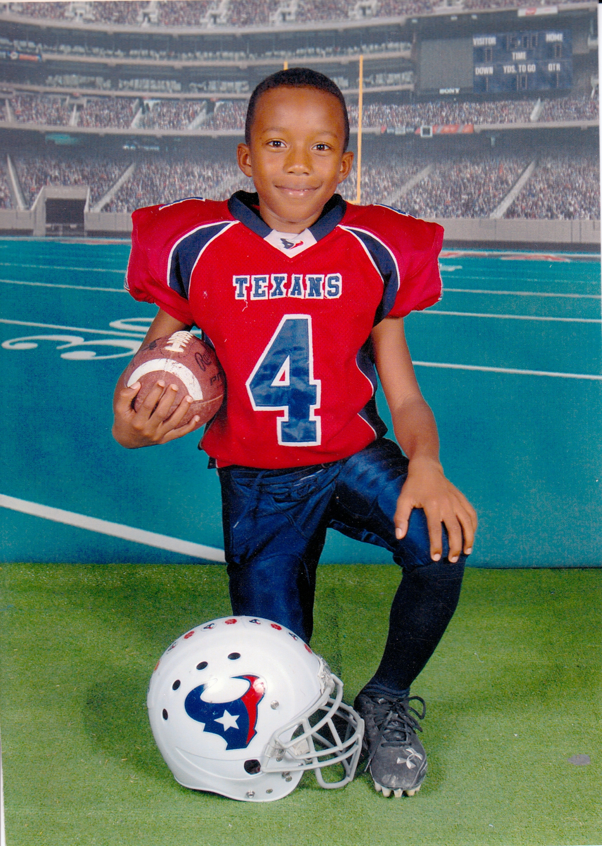
Doitfordamani.com
#DoItForDamani

Slide 3
SCA TRAINING IS MORE THAN KNOWING CPR

Slide 4
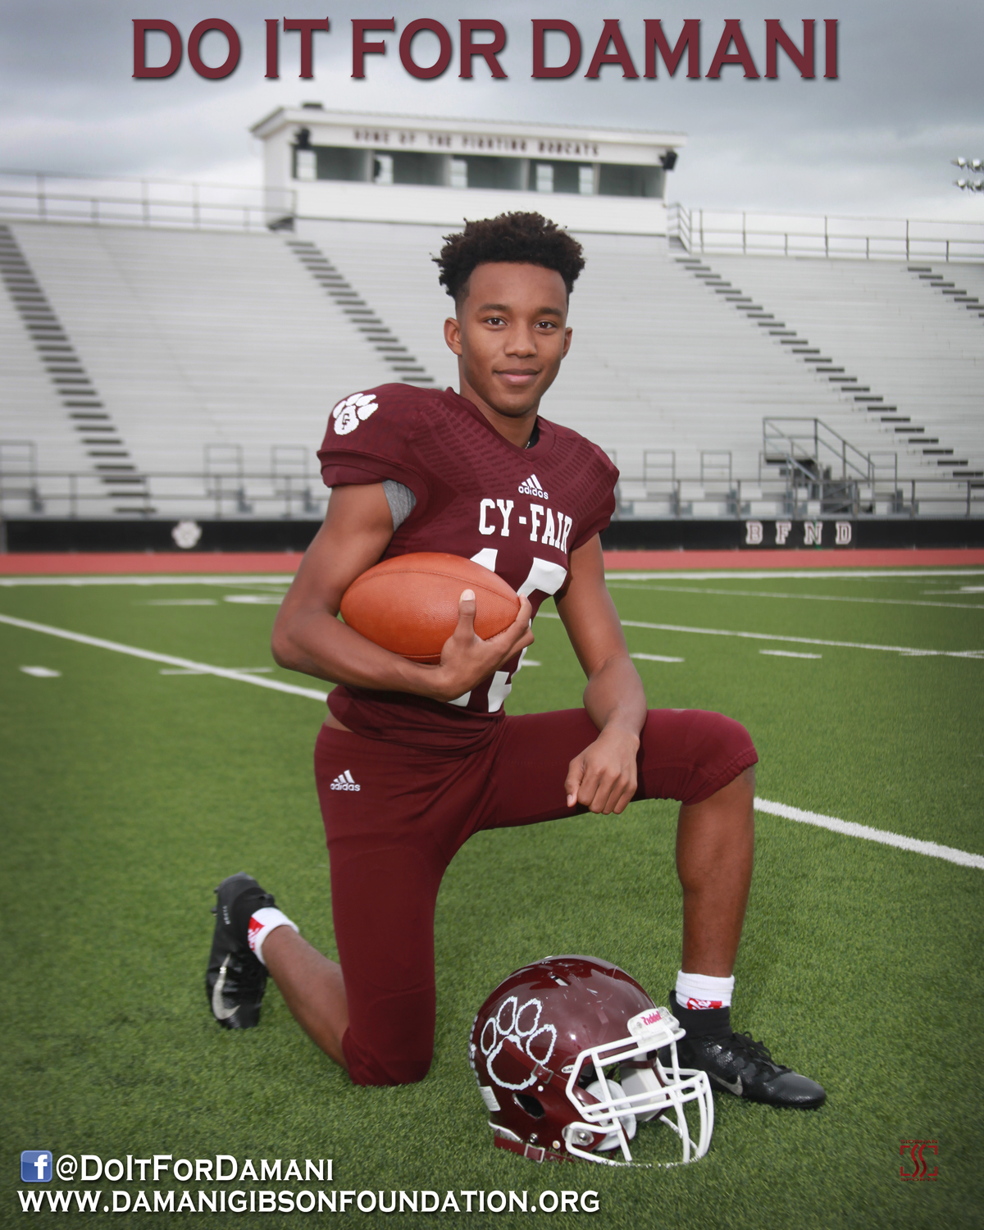
Do it For Damani Protocol
Awareness-Training -Planning
AWARENESS
Inform of the risk
PREVENTION
Heart Screening Exams For Youth every 2 years
RESPONSE
Train all youth in CPR
Awareness Videos
Discuss at Parent Meetings
Team Simulation Drills & Discussions
Train Staff in return to play protocol
Plan 2 Team Drills
Schoolwide Emergency Drills

Slide 5
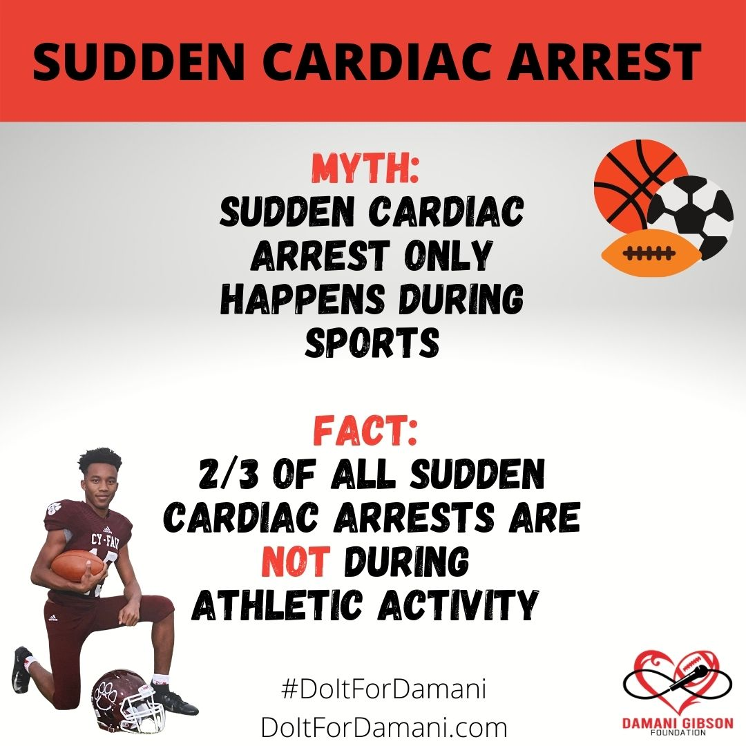
DISPELLING THE MYTHS

Slide 6
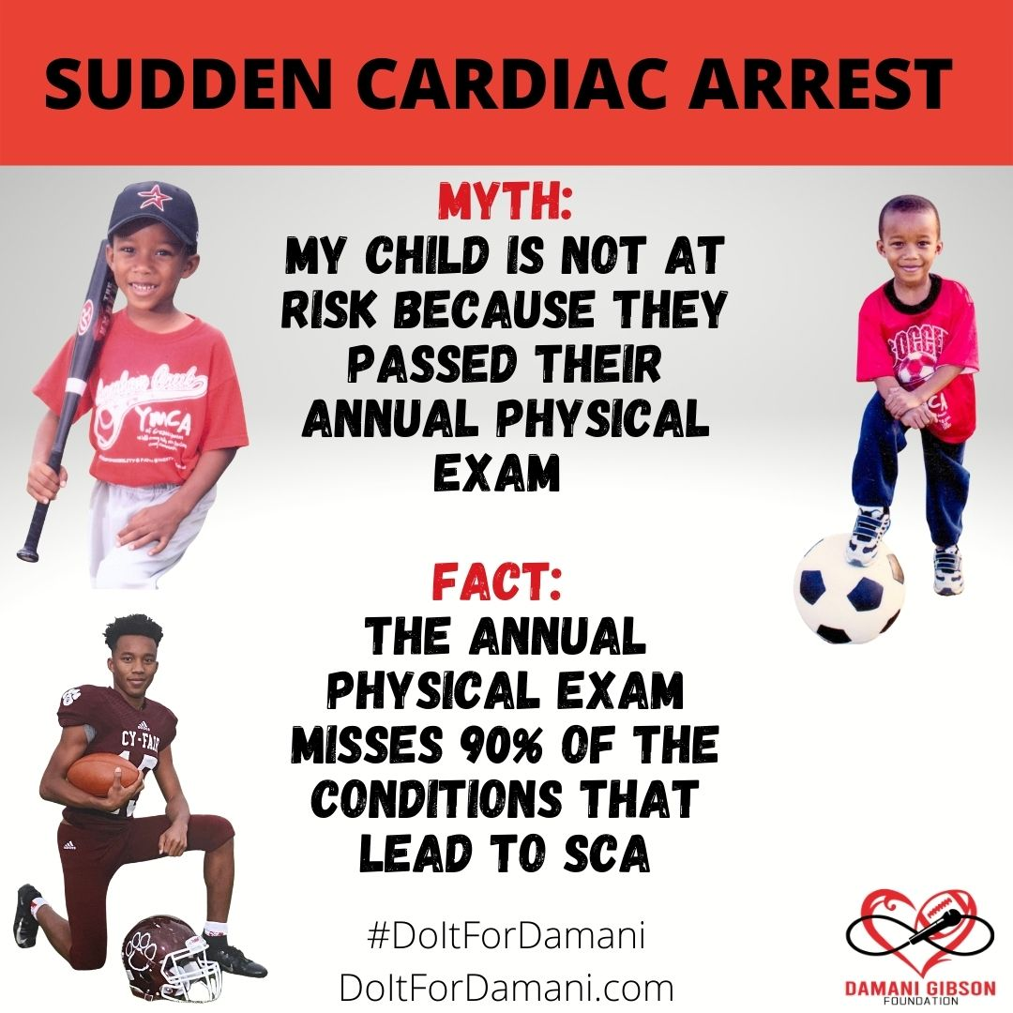
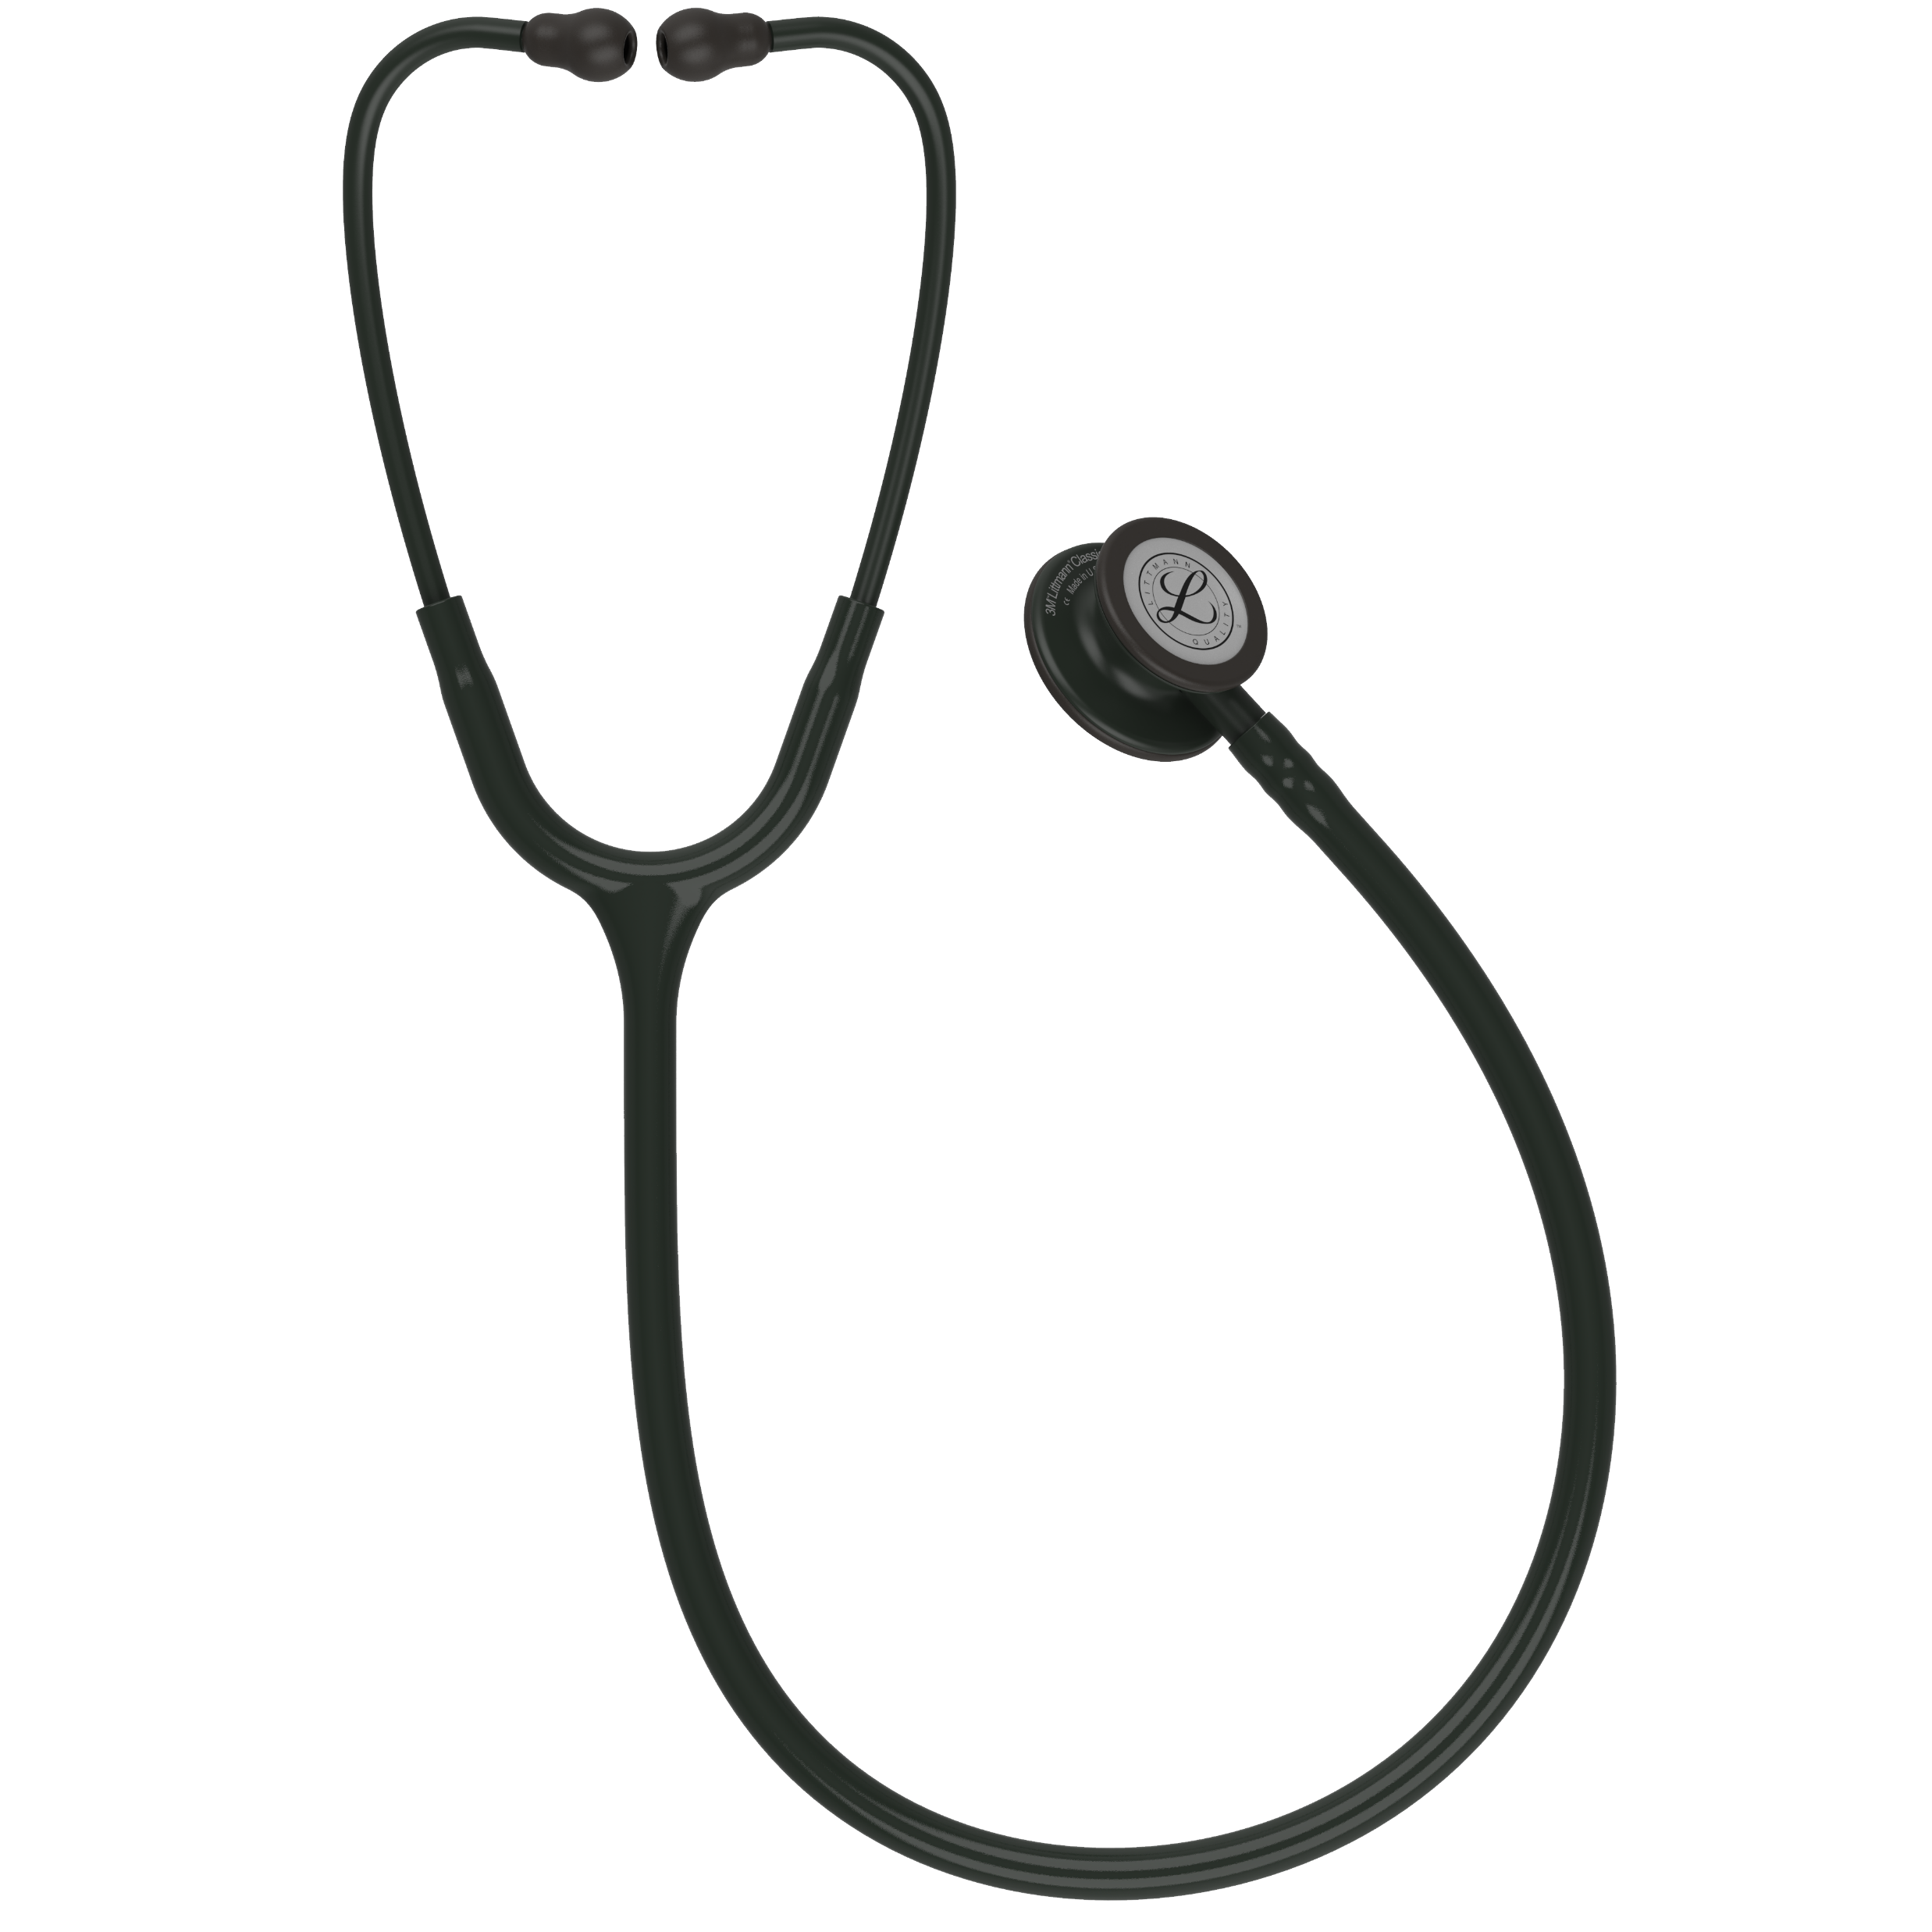
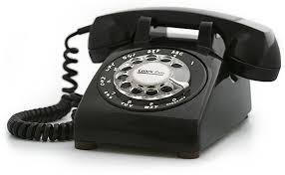
Outdated Technology

Slide 7
Who Does It Effect
SCA can strike persons of any age, gender or race, including those that seem in good health and at peak physical fitness
Most youth with undetected heart conditions typically appear very healthy
Many youth never exhibit signs or symptoms until SCA occurs
SCA is the leading cause of death in young athletes

Slide 8
Fainting (syncope) or seizure during or after physical activity
Dizziness / lightheadedness during or after physical activity
Fainting or seizure resulting from emotional excitement, emotional distress or startle
Unexplained fainting or seizures
Chest pain or discomfort / racing heartbeat
Unusual shortness of breath
Unusual fatigue / tiredness
Family history of heart disease
Family history of unexpected sudden death during physical activity or during a seizure, or any other unexplained

Slide 9
SCA ON CAMPUS
#1 Killer On Campuses
1 in 25 Schools will have SCA each year
132,853 schools in US
5,314 will have an SCA incident

Slide 10
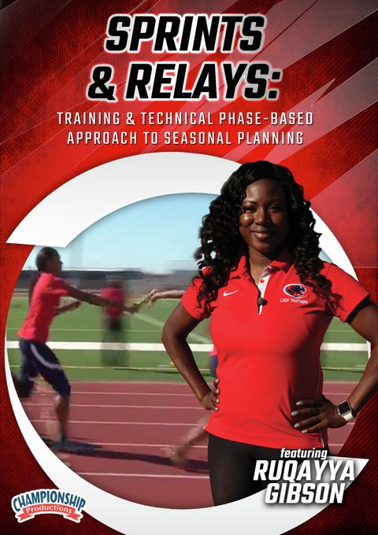
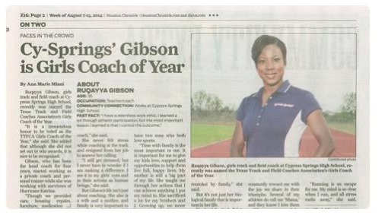

Slide 11
STAY READY
ARE YOU PREPARED?
WHAT’S THE PLAN?

Slide 12
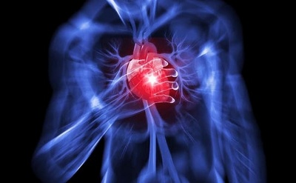
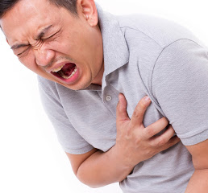
WHAT DOES SCA LOOK LIKE?
SEIZURE
RESTING
COLLAPSE
CONCUSSION
    REFER TO SPECIFIC STORIES

Slide 13
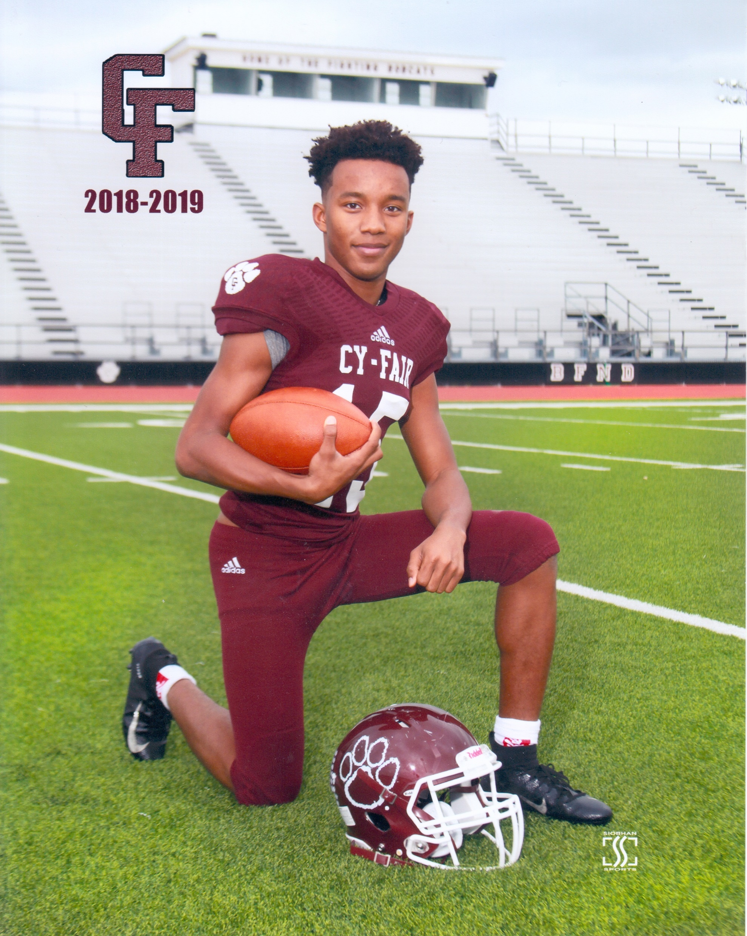
30 Million Youth Participate in Sports Each Year
3.5 million injuries Estimated
#1 cause of Fatalities is SCA
No Protocol in Place
KNOW YOUR STATUS- EKG not a 1 and done!

Slide 14
More Common Than Cancer
2/3 of SCA will not be during sports
Every 3 days an Athlete will die from SCA
1/3 of SCA deaths will not find cause

Slide 15
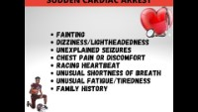

Slide 16
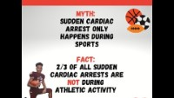

Slide 17
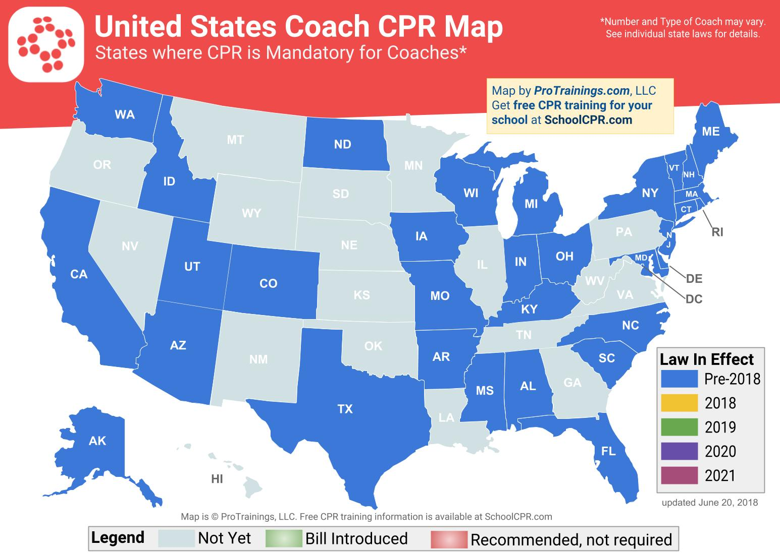

Slide 18
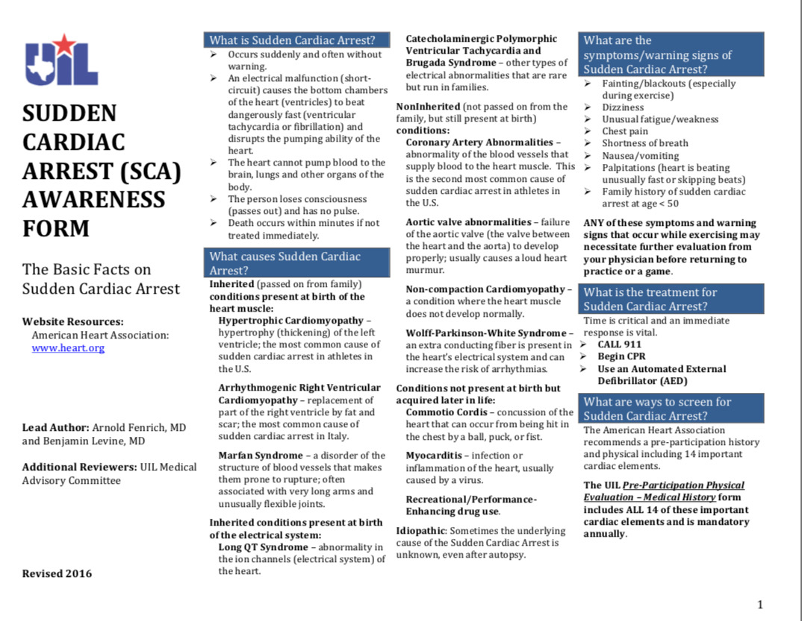
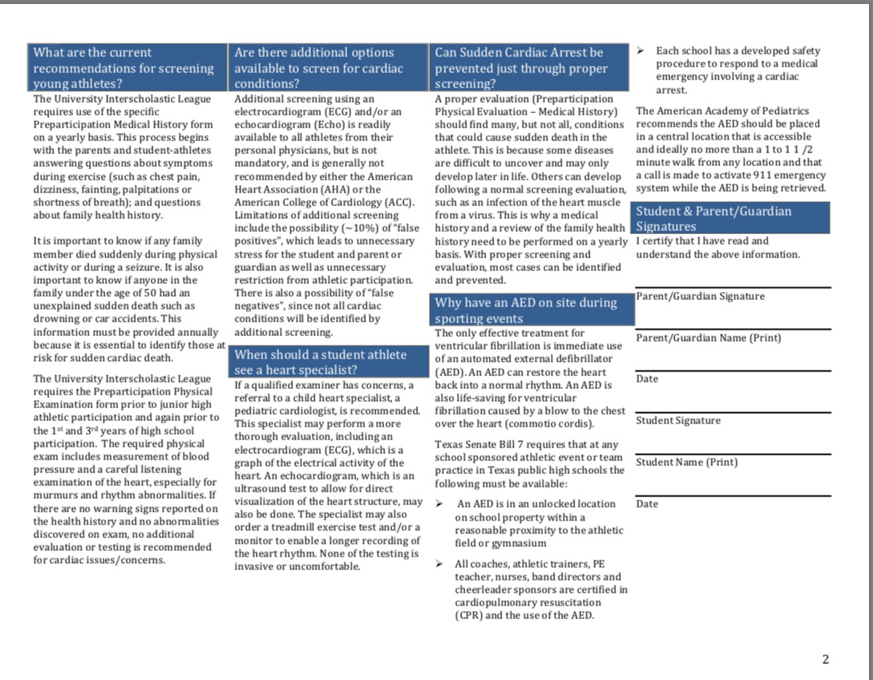















Slide 19
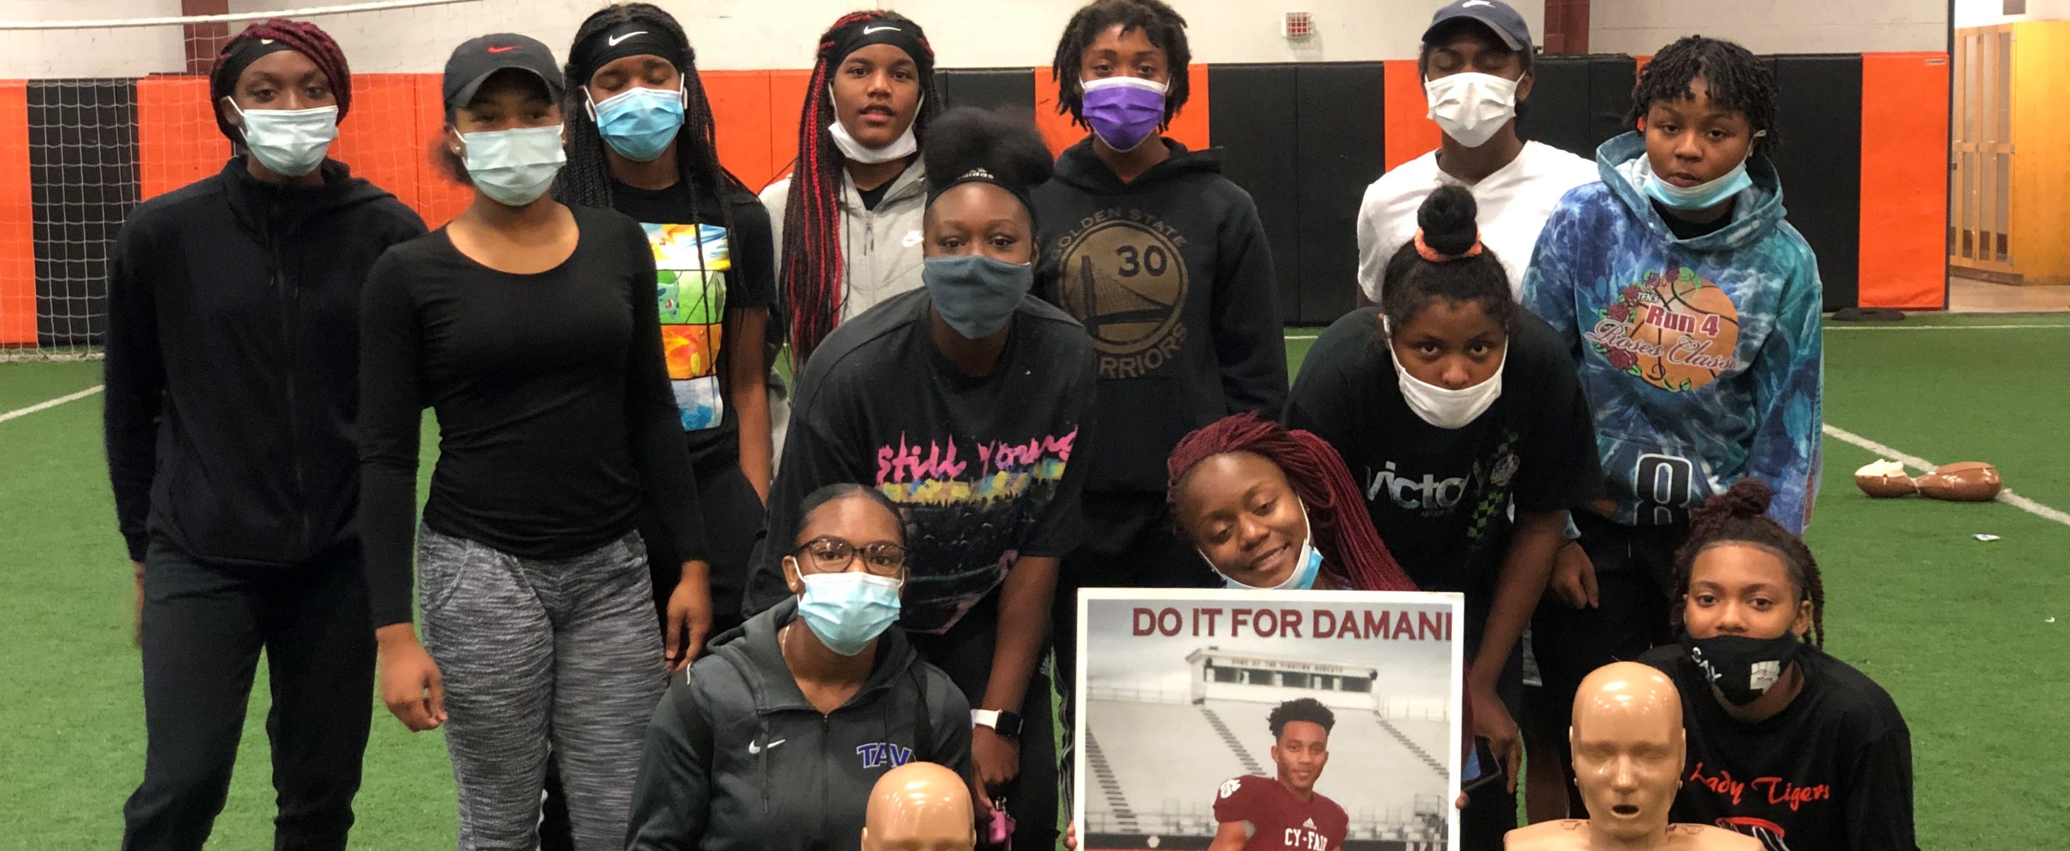
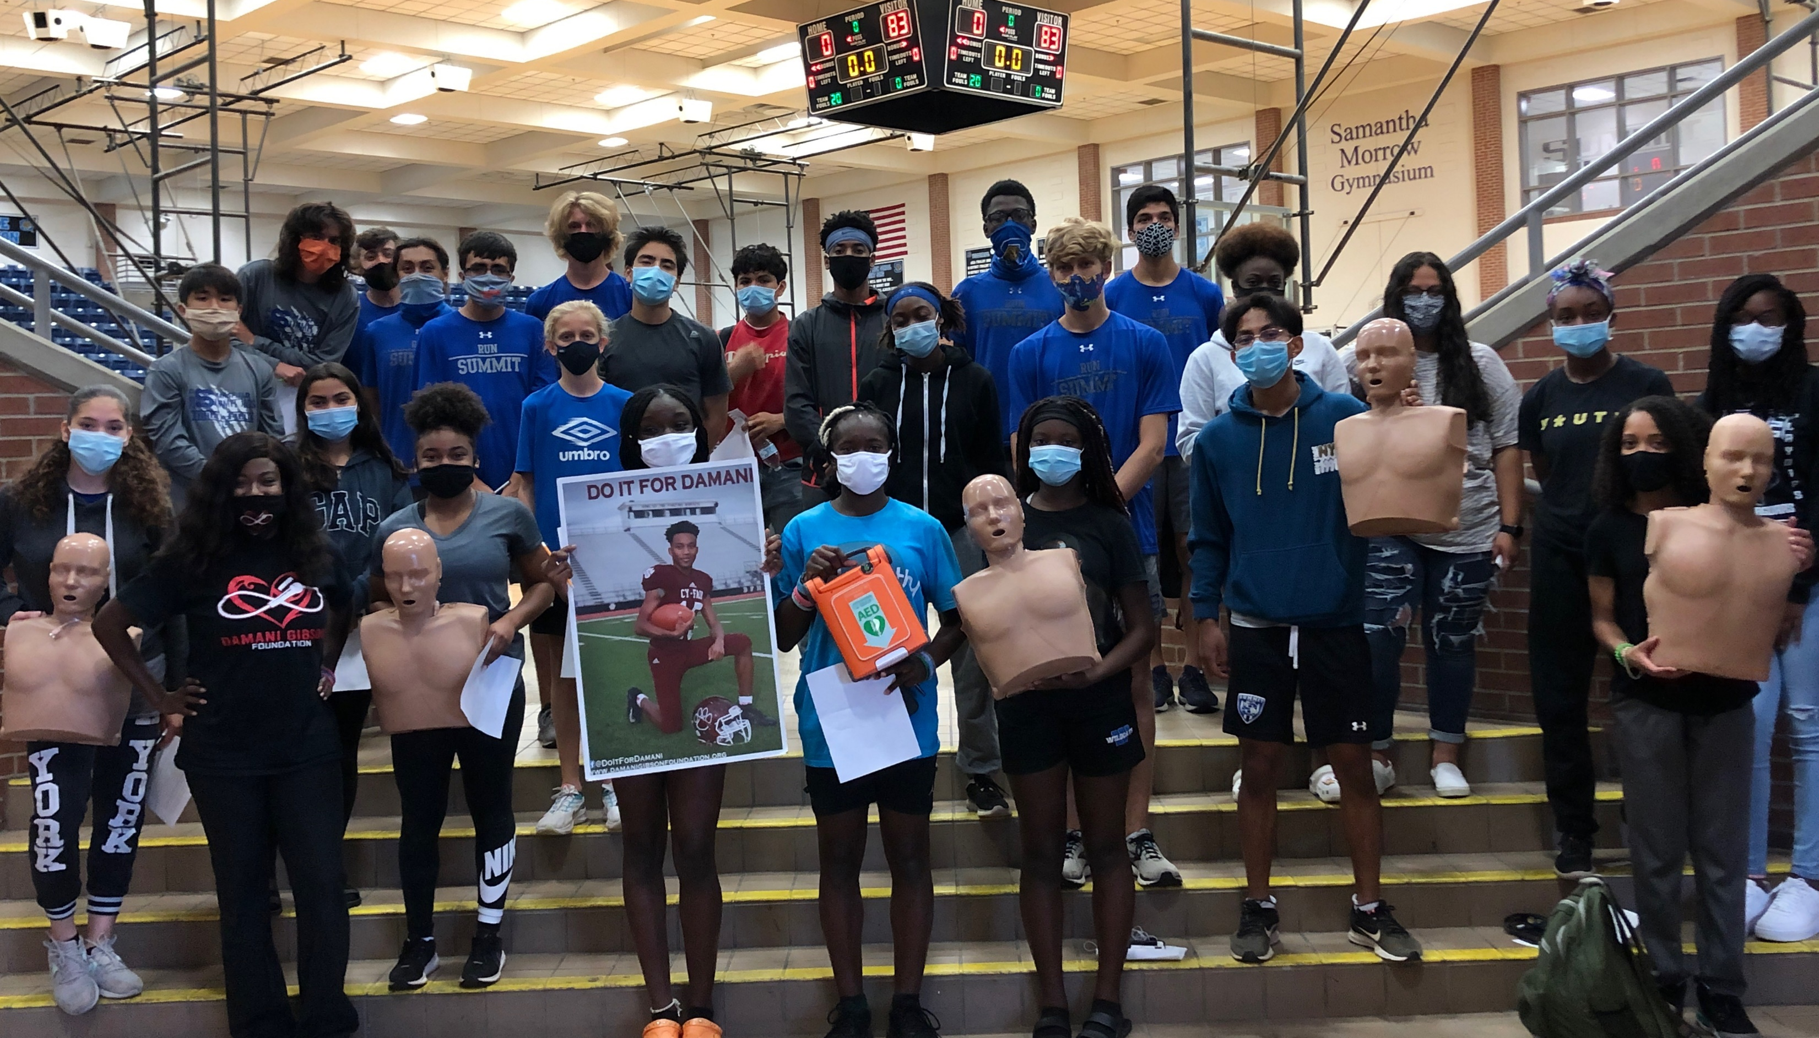
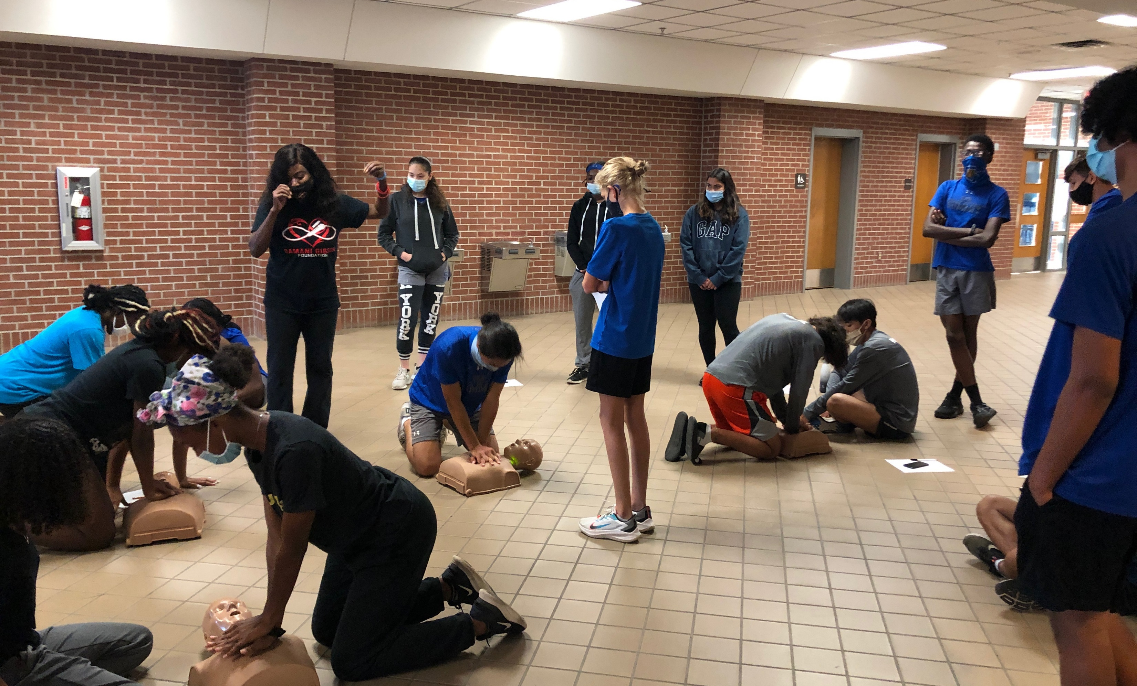
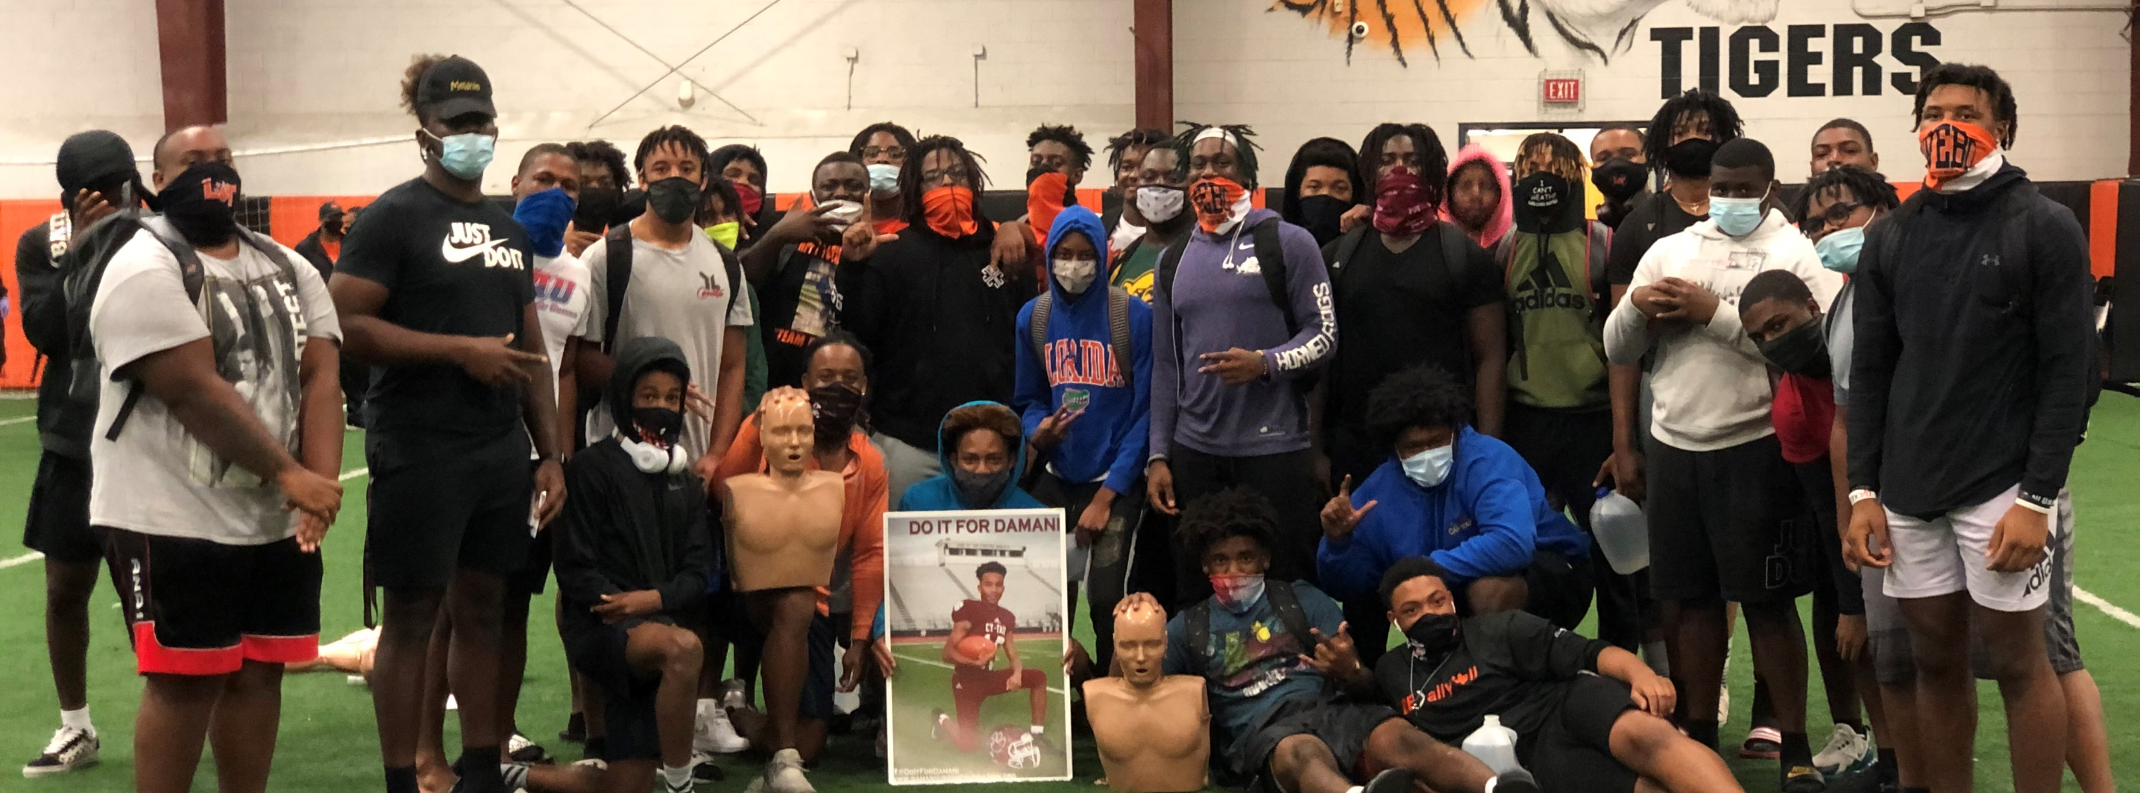

Slide 20
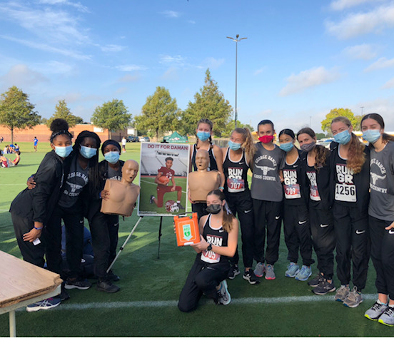
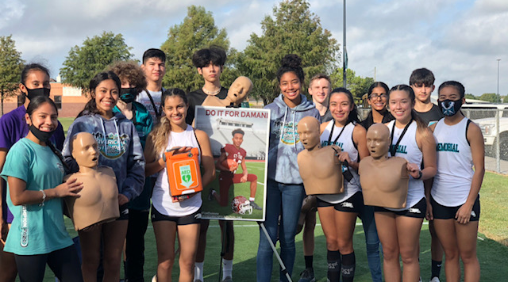
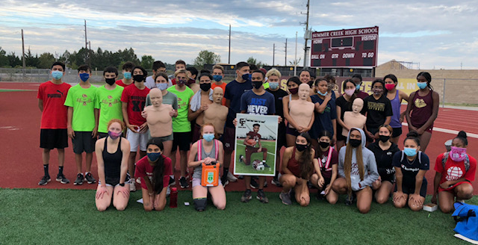
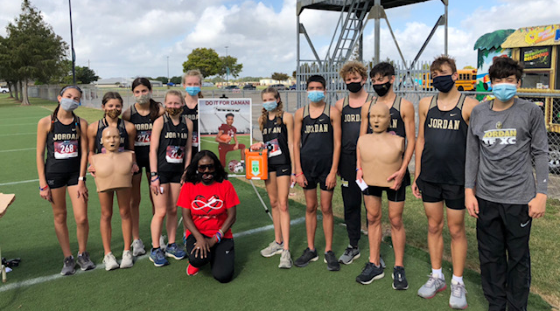

Slide 21
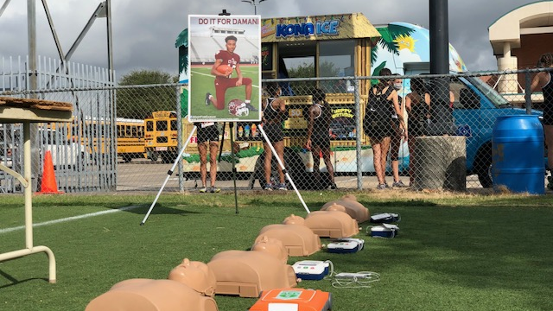

Slide 22
More Deaths from
SCA than
Childhood & Breast
Cancer Combined
Most Teams Pink Out
CAN WE CREATE SCHOOLWIDE AWARENESS
DAYS FOR SCA?

Slide 23
HOW DO WE RESPOND TO SCA IN THE CLASSROOM?
DO YOUR TEACHERS KNOW WHAT TO DO?
DO YOUR STUDENTS KNOW WHAT TO DO?

Slide 24
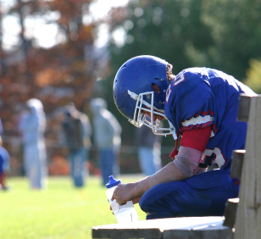
SCA ASSUMED TO BE
DEHYDRATION
OVERHEATING
OVEREXERTION

Slide 25
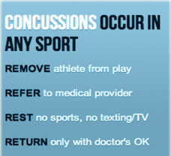
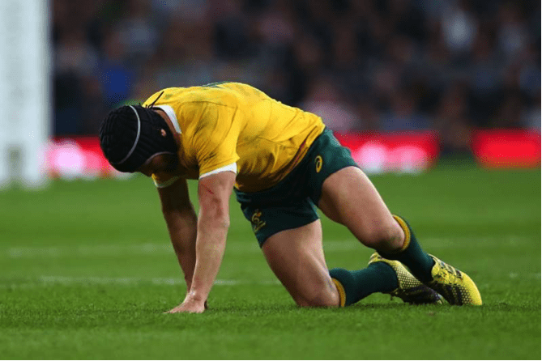
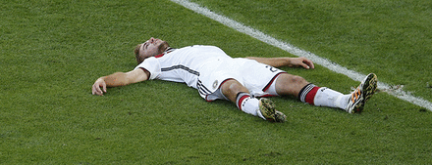
PROTOCOL
CONCUSSION PROTOCOL
HEAT ADVISIORY PROTOCOL
LIGHTNING PROTOCOL
NO SCA PROTOCOL

Slide 26

WORK WITH TEAMS TO MAXIMIZE IMPACT

Slide 27
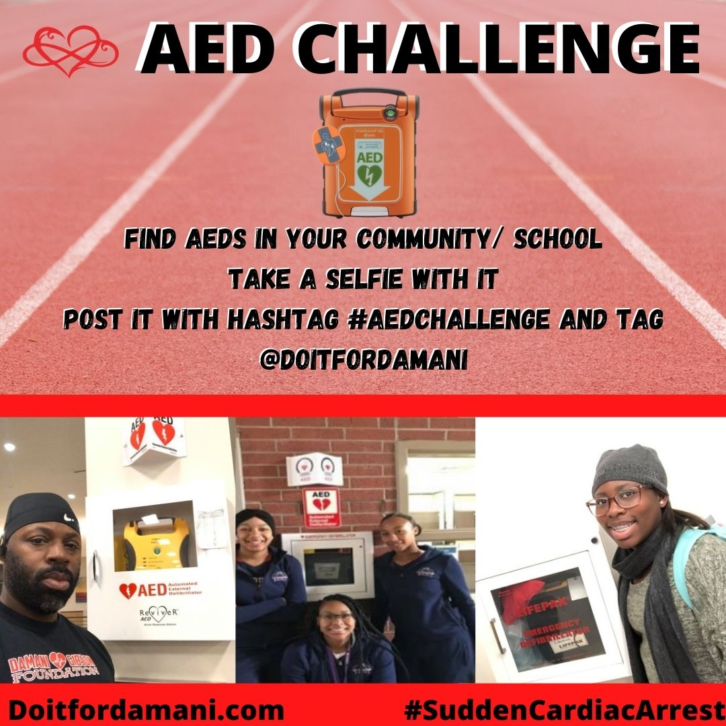
#AEDCHALLENGE

Slide 28
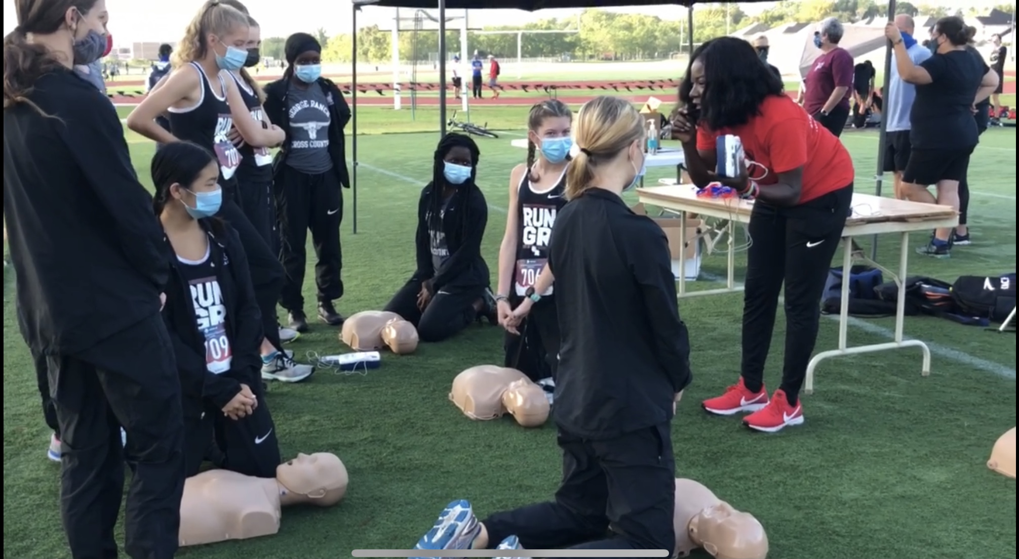
EMERGENCY DRILLS
1ST WEEK PROCEDURE TALKS
ADVISORY MEETINGS
STAFF MEETINGS

Slide 29
SUGGESTIONS
REVIEW YOUR STATE’S SCA FACT SHEET
OFFER TO SPEAK AT PARENT MEETING (OR PROVIDE FACT SHEET)
DISCUSS RETURN TO PLAY AFTER SYMPTOMS
SUGGEST SCA PROTOCOL
OFFER HEART SCREENINGS
SUGGEST MORE CPR PRACTICES
TELL YOUR STORY

