Slide 1
What’s Next? A Year Later – Pandemic Procedures and Protocols
Scott Lillibridge, MD
Emergency Response Unit Director & Senior Medical Adviser
International Medical Corps

Slide 2
Presentation Overview on Temperature Monitoring
What are we going to cover in this presentation?
Why is monitoring important?
Clinician and public health perspectives on monitoring

Slide 3
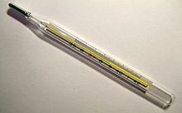
Timeline on Temperature Measurements
History of Temperature Monitoring
Early Investigator Carl Reinhold Wunderlich (1815–1910)
Modern Use Based on Physiology
New Technology
Continuous Monitoring
Linkage to other Vital Signs

Slide 4
Modern Uses of Temperature Testing
Measuring a person’s temperature is still very important in medicine
Diseases are associated with a change in body temperature and the course of the disease can be followed by temperature Changes
It is a Measure Effectiveness of Treatment
A fever is the reaction to a disease-specific stimuli.
\

Slide 5
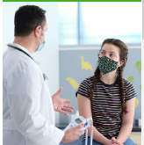
Temperature Monitoring and COVID-19
Individual Patient Monitoring
Mass Screening

Slide 6
How will COVID-19 Vaccine Affect Students
Affects Return to School Decisions
Monitoring Procedures May Change
Affects Strategies to Reduce the Transmission of Disease
Reduce the Burden of Environmental Disease Control Measures

Slide 7
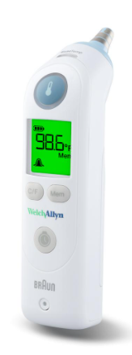
Trends In Temperature Monitoring
Medicine is moving to disposable and non-contact temperature monitoring
If disposable or non-contact thermometers are used, you do not need to change gloves before the next check. CDC Feb 11, 2021

Slide 8
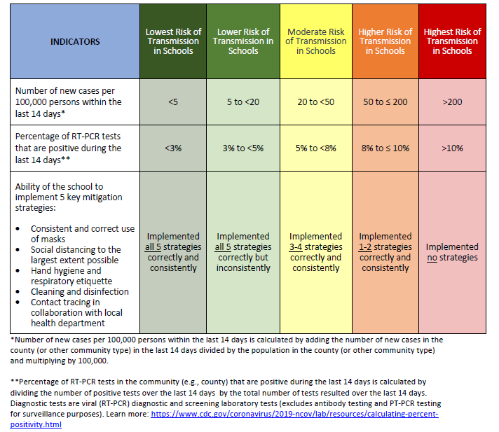
Keeping Students Safe in the Time of COVID-19
Effective Policies (Re-opening Schools)
How can School Nurses Improve Safety?
School Based Disease Surveillance

Slide 9
Proper Use of Temperature Screening Going Forward
Recent Controversy on Effectiveness of Temperature Monitoring
Timely Studies (CDC, etc)
CDC Now Recommending Screening be Adapted to Circumstances
Effective Temperature Screening Strategies
Screening Tools & Technology
Health Monitoring Should begin at Home!

Slide 10
Conclusion
Temperature Measurements are Still Important
Temperature Monitoring Trends and Equipment in the Future
Point of Care
Lower Cost
Networked – Linked to other Vitals
Privacy

