Slide 1
Learn and Play from Home: Ways to Encourage Home Learning Through Sensory and Play Activities
By Raveena Kingra OTR/L

Slide 2
Objectives
How to create a routine for your student/child
At-home sensory strategies to promote learning
At-home education/play strategies to promote learning K-12

Slide 3
Routine
Routines are important to normalize the day for students
For non-verbal and young children/students create a picture routine
Talk with parents to see what their schedules are like and create a customized schedule

Slide 4
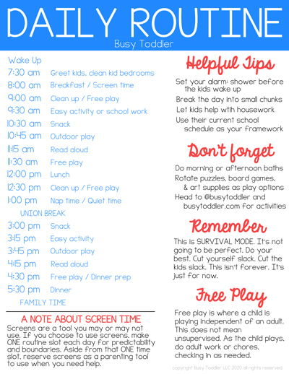
Courtesy of https://busytoddler.com/2020/03/dailyschedule-covid-19

Slide 5
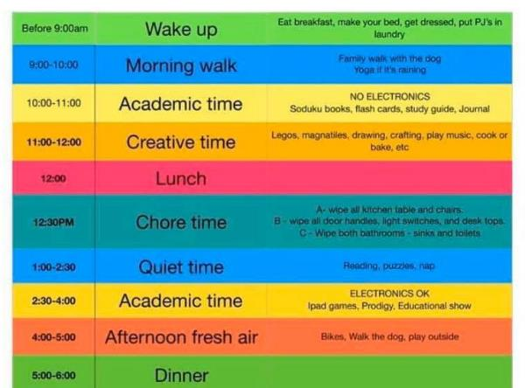
Example Written Schedule
Courtesy https://oilcity.news/community/2020/03/15/child-development-center-offers-ideas-for-home-based-activities-during-covid-19-closure/

Slide 6
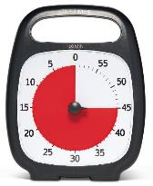
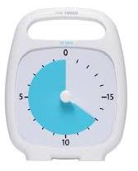
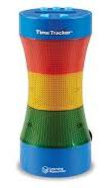
Timers

Slide 7
Sensory Strategies

Slide 8
Importance of Vestibular Input
Vestibular input is the sensation of any change in position, direction, or movement of the head
2-3X per day, in the morning, afternoon, and evening, can help arousal levels to perform activities
15 minutes of vestibular input can last up to 12 hours
Have child participate in vestibular input before completing an activity that requires sitting down/focusing

Slide 9
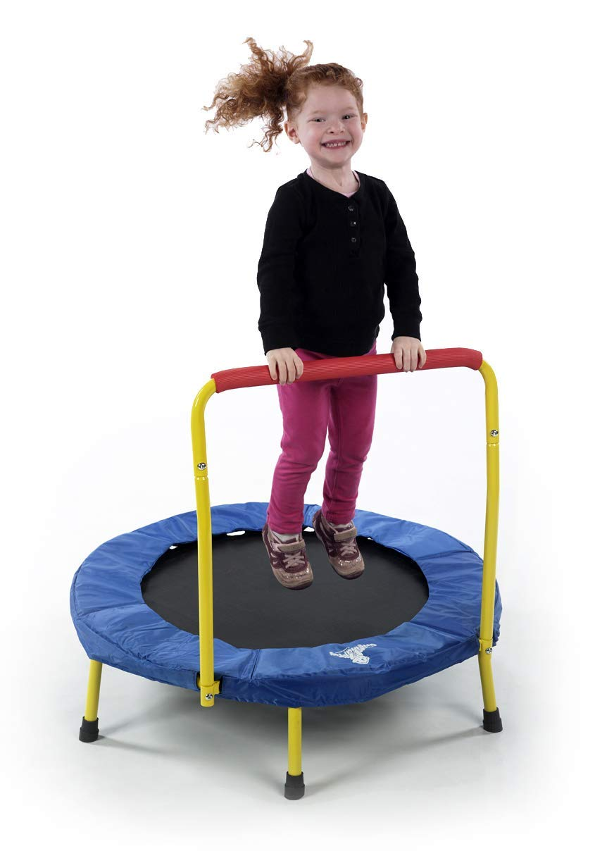
Alerting Qualities of Vestibular Input
Child is sluggish, show, tired
Unexpected, rapid movement
Bumpy, jerky movement
Changing direction
Bouncing
Head inversion (upside down)

Slide 10
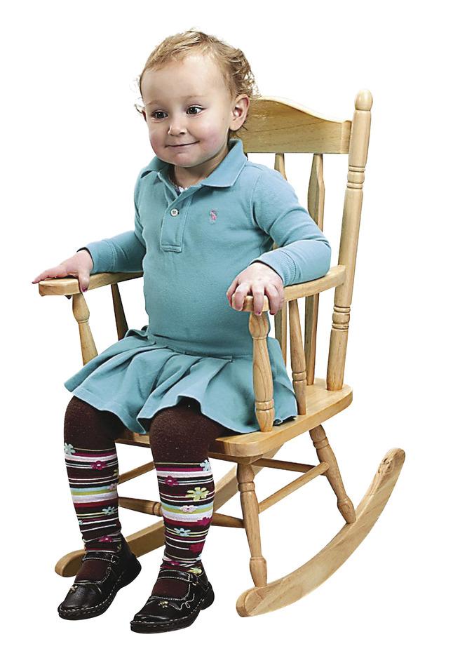
Calming Qualities of Vestibular Input
Child is crying, running, hitting, tantruming
Slow, rhythmic movement
Linear movement (one direction)
Slow movement provided by deep pressure
Predictable movement

Slide 11
Importance of Proprioceptive Input
Proprioception is body awareness
For students seeing proprioceptive input (crashing, climbing, holding pencil with deep pressure, seeking deep pressure) behaviors will lessen and students will be able to engage in learning
Provide INTENSIVE INPUT to muscles and joints
Weight bearing activities – crawling, push-ups
Resistance activities – pushing, pulling
Heavy lifting – carrying books
Running, jumping
Deep pressure – tight hugs, compression vest, weighted backpack, weighted lap pad
Oral input – chewies

Slide 12
Behaviors
Proprioceptive Avoiding
Appears lazy or lethargic
Avoids active activities (running, jumping, climbing)
Can be a picky eater
Prefers to sit still
Avoids touch from others
Seem uncoordinated
Needs to look to do familiar activities
Difficulty using stairs
Proprioceptive Seeking
Runs into objects, walls, or people
Uses extreme force
Stomps, walks loudly
Poor body awareness
Kicks, bites, and hits
Poor personal space
Prefers tight clothing
Chews clothing, pencils, fingers

Slide 13
Sensory Strategies at Home
Swinging
Riding a bicycle or taking a walk
Swaying in a hammock
Rock in rocking chair or rocking horse
Lie on couch with head down looking at ceiling
Rhythmic bouncing or rolling on large therapy ball
Pulling child on a blanket
Swinging in a blanket
Jumping on trampoline or in bounce house
Log rolling – roll back and forth to retrieve objects like clothes or shoes
Sit and spin or spinning in office chair
Scooter boards
Bouncing on a large ball
Pass ball over head and through legs
Summersaults
Dancing, marching, twirling
Imitating head positions
Slide and climb on playground equipment
Shake and stretch body
Create an obstacle course to crawl under, over, through chairs, cushions, pillows, etc.
Jumping rope
Look through these strategies to inform parents which ones are best for the specific student

Slide 14
School vs At-Home
School
Swinging in a linear movement for calming input
Pushing a weighted cart
Movement break
Jumping on a trampoline
Compression vest
At-Home
Rocking in rocking chair
Swinging in blanket or hammock
Helping with vacuuming, carrying laundry basket, carrying box of toys
YouTube movement break
Go for walk (Go Noodle)
Jumping on trampoline or bed
Compression vest

Slide 15
At Home Sensory Strategies
Student seeks pressure and proprioceptive input before completing a task. He would benefit from the following recommendations that should be completed for 15 minutes before sitting and attending to a task.
Squeezes on shoulder and arm (joint compression)
Carrying bin of toys from one room to another
Completing a puzzle or activity with belly on the floor (prone)
Throwing/kicking a heavy ball
Wheelbarrow
Rolling a therapeutic ball on back/bouncing on a therapeutic ball/completing activity with stomach on therapeutic ball

Slide 16
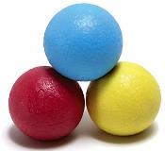
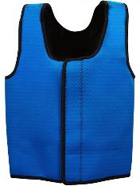
Sensory Diets At Home
Items parents can use to complete sensory diets at home based on recommendations or the OT
weighted rubber textured balls
compression or
deep pressure vest

Slide 17
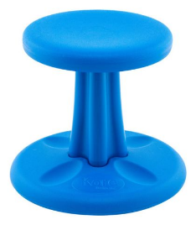
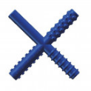
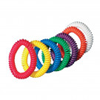
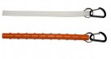
Sensory Diets at Home
Wobble chair
Oral motor chews

Slide 18
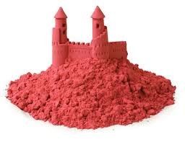
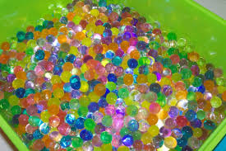
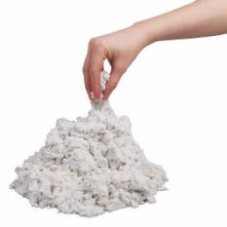
Tactile Activities
Sands
Water beads

Slide 19
Sensory Activities with Supplies at Home
Rice and beans in a bin
Shaving cream
Making slime/play dough

Slide 20
At-Home Learning

Slide 21
Early Childhood, Kindergarten, First Grade
Pre-writing strokes
Coloring
Cutting with scissors
Stringing beads
Learning the alphabet and sounds
Dressing
Toilet training
Making a simple craft
Following one-two step directions
Writing/tracing name
Hand strengthening activities
Core strengthening
Try not to overwhelm the parent; focus on one task a week

Slide 22
Early Childhood, Kindergarten, First Grade
Pre-writing strokes
Coloring
Cutting with scissors
Stringing beads
Making slime/play dough

Slide 23
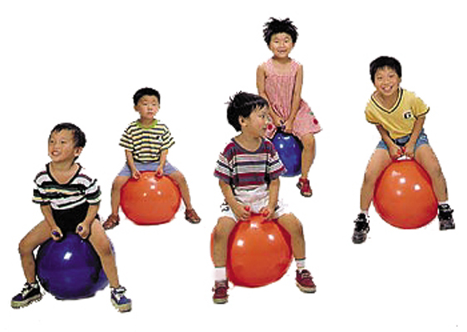
Core Strengthening Activities
Relay race of different poses!
Bear walk
Crab Walk
Bouncing on a therapeutic ball

Slide 24
Hand Strengthening Activities
Playing with playdough (try putting bead in and have kids pinch them out)
Crumpling paper into a small ball
Squeezing sponges when taking a bath
Water spray bottles, squirt gun
Playing with Legos
Stirring cookie/cake batter
Cutting with scissors, coloring pictures
Playing on a playground (climbing)
Relay racing (bear crawls, wheelbarrow walks)
Playing Twister
Playing Operation
Squeezing a glue bottle (making crafts)

Slide 25
2nd, 3rd, 4th Grade
Handwriting (writing words and sentences)
Cutting complex shapes
Coloring complex pictures
Hand strengthening
Core strengthening
Categorizing (animals, foods)
Understanding feelings and emotions
Completing a puzzle
Crafts

Slide 26
Make Handwriting Fun
Use different mediums
Shaving cream
Chalk board
Dry erase board
Paint with Q-tips
Use First, Then board
Speak enthusiastically when child has tried the activity

Slide 27
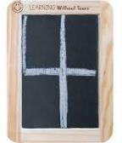
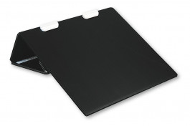
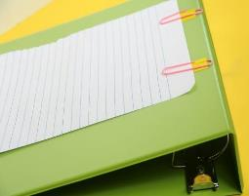
Make Handwriting Fun
Slate chalkboard
Slant board
Homemade slant board

Slide 28
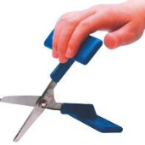
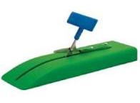
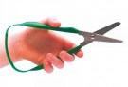
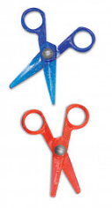
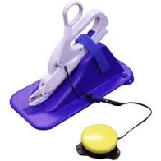
Scissors
Many different types of scissors.
Ask your OT which scissors are suitable for your child!

Slide 29
5th, 6th, 7th, 8th Grade
Learning to type (www.typing.com)
Teaching emotion regulation skills
Increasing technology skills
Increasing organizational skills
Following multi-step directions
Hand strengthening
Core strengthening
Playing board games (match based on cognition)

Slide 30
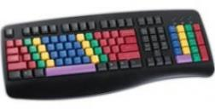
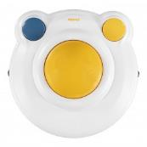
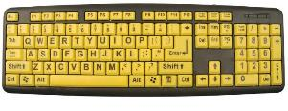
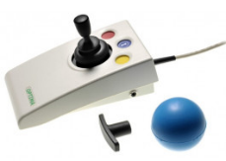
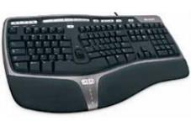
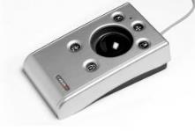
Technology

Slide 31
High School
Focus on becoming independent/participating in household
Cleaning, cooking, doing laundry
Writing a resume
Using Google Maps
Following multi-step directions/list
Playing board games
Playing sports

Slide 32
Chores
Easy Tasks
Making bed
Folding and putting away clothes
Wiping surfaces
Taking out trash
Vacuuming floors
Model safety
Washing dishes
Model to your child the steps to wash dishes
Practice safety with them by supervising
Doing laundry
Model to your child the steps to do laundry
Practice safety with them by supervising
Talk with the OT and Speech therapist to determine if it is safe for your child to do more complex tasks without OT supervision. Safety is our number one priority!
Hard Tasks

Slide 33
Safety
Always discuss safety with your child when performing chores
What should they do if a glass breaks while washing dishes?
How long should they wait after microwaving food?
Ho do they safely plug something in?
How do they safely cut a sandwich in half?
Can they verbalize/understand the proper steps to complete ______?
Can they verbalize/understand how to practice the activity safely?

Slide 34
Citation
Busy Toddler
https://busytoddler.com/2020/03/daily-schedule-covid-19/
Pillar Child Development
https://www.pillerchilddevelopment.com/vestibularInput.php
Lemon Line Adventures
https://lemonlimeadventures.com/proprioceptive-input-sensory-processing-explained/

