Slide 1
SCA Straight Talk:
Saving Our Students
One Heart at a Time

Slide 2
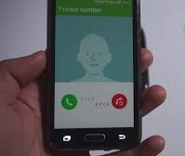
A Phone Call
Changed My Life

Slide 3


Peyton Walker
December 19, 1993 – November 2, 2013
Notes:
Peyton was a sophomore at King’s College.
Working as a scribe in the ER – never made it.
SCA stole her life that morning
Peyton looked forward to working in healthcare.
She has an older sister and a younger brother.
She loved 4-wheeling in her Jeep Wrangler, snowboarding, rock climbing, ziplining…anything dangerous
She looks healthy. She was fun, energetic, full of life.
And cardiac arrest stole her young life

Slide 4

“What we do for ourselves dies with us.
What we do for others and the world remains and is immortal.”
- Albert Pines

Slide 5

Our Mission:
Increasing awareness and survival rates
of Sudden Cardiac Arrest

Slide 6
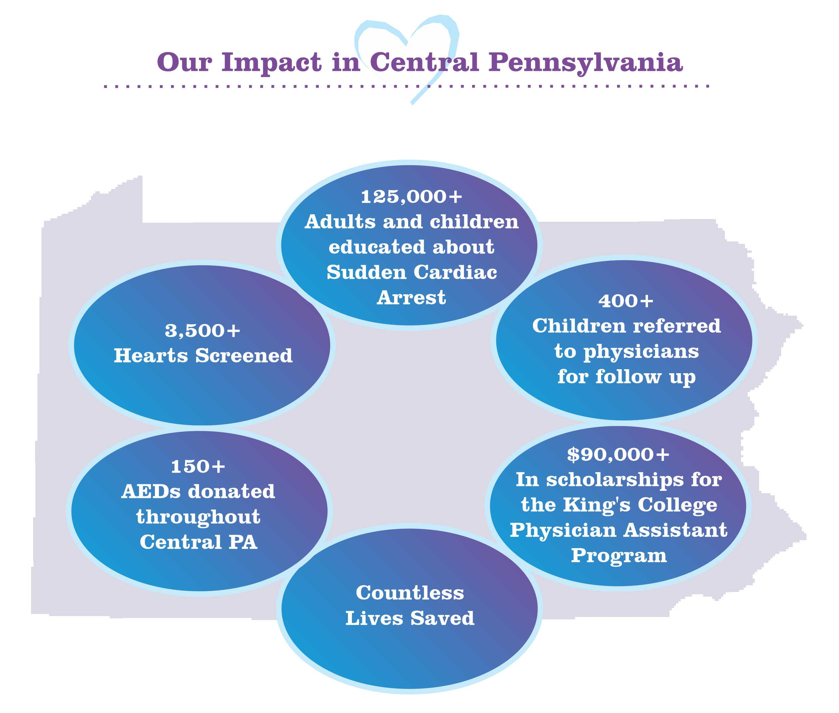

Slide 7
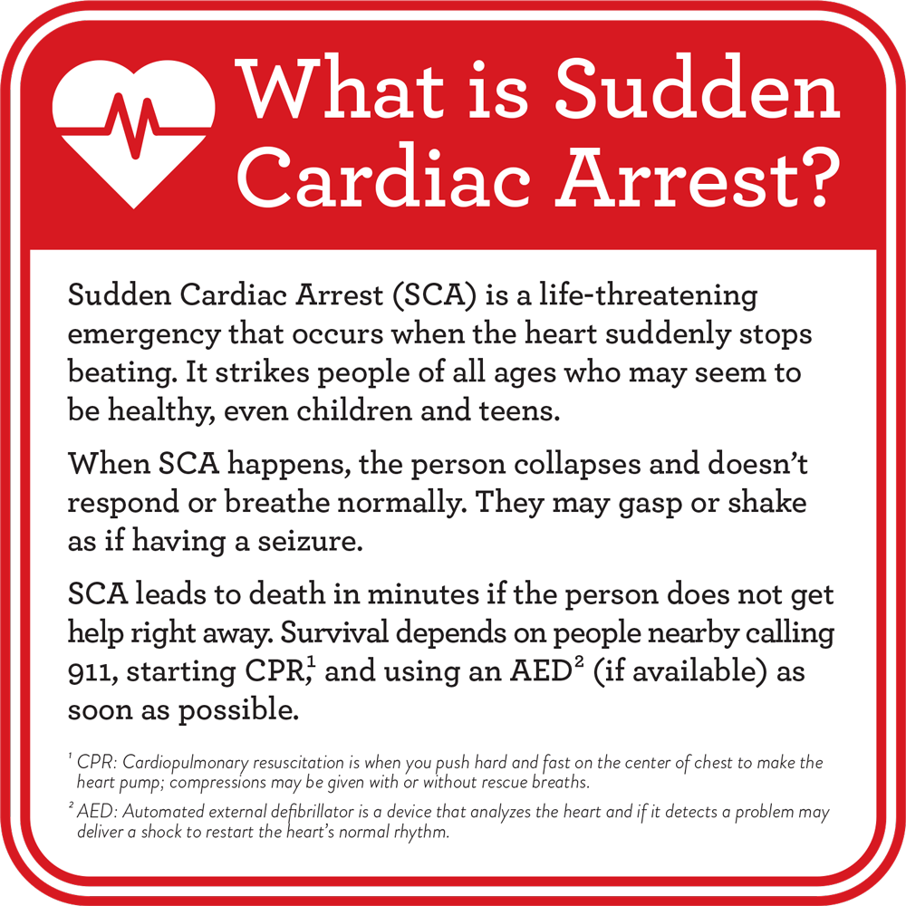
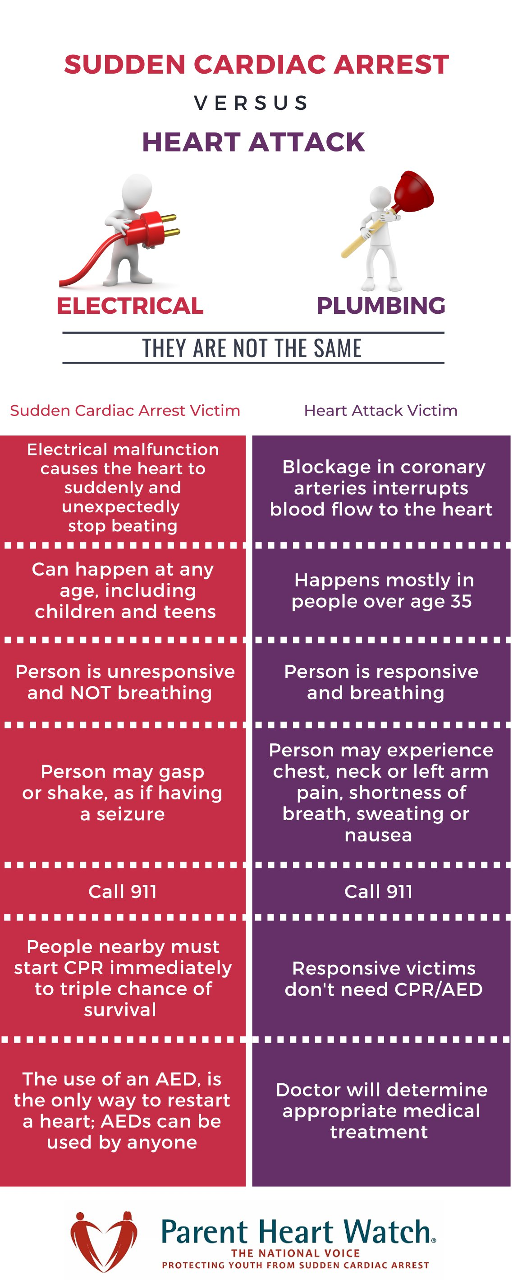

Slide 9
SCA
Heart Attack

Slide 10

Heart Attack = Plumbing Issue

Slide 11

Sudden Cardiac Arrest = Electrical Issue

Slide 12
Has there been a sudden cardiac arrest incident within your school?

Slide 13
Sudden Cardiac Arrest
is the #1 killer of
student athletes
in our country

Slide 14
Sudden Cardiac Arrest
is the leading cause of death on school campuses

Slide 15
Sudden Cardiac Arrest
is the
#2 medical cause of death
in youth under 25

Slide 16
Sudden Cardiac Arrest
Survival rates are less than 10%
= 90% of SCA events lead to death

Slide 17
Sudden Cardiac Arrest
Takes the life of
one child every hour of
every day

Slide 18
Sudden Cardiac Arrest
Every statistic represents a devastated family
left behind.

Slide 19
Sudden Cardiac Arrest
Ripple effect of losing a young person suddenly and without warning
has a long-lasting impact
on classmates & friends

Slide 20
Signs & Symptoms of an Underlying Heart Issue
Fainting or seizure, especially during or right after exercise
Fainting repeatedly or with excitement or startle
Chest pain or discomfort with exercise
Racing heart, palpitations or irregular heartbeat
Notes:
Kids often don’t report signs or symptoms – all too often, these are “normal” occurrences in kids and they don’t recognize or realize they are abnormal and could be an indication of an underlying heart issue

Slide 21
Signs & Symptoms of an Underlying Heart Issue
Dizziness or lightheadedness
Excessive, unexpected fatigue during or after exercise
Excessive shortness of breath during exercise

Slide 22
What causes SCA?
Hereditary Heart Conditions
  Hypertrophic Cardiomyopathy - Leading cause of SCA in youth
  Long QT Syndrome
Viral / Myocarditis
Coronary Artery Abnormalities
Commotio Cortis
Energy Drinks / Medications
Notes:
Hypertrophic cardiomyopathy – or HCM - is the #1 cause of SCA in youth. It is usually inherited and often goes undiagnosed. Thickening of the lower chamber can cause abnormal heart rhythm.
Coronary Artery Abnormalities – 17% - These are defects in the way the coronary arteries connect to the heart – can lead to decreased blood supply to the heart muscle.
Other – Arrhythmias – affect the heart’s electrical impulses. Include, among others:
Long QT Syndrome (fast & chaotic heartbeats).
Wolf Parkinson White (WPW) – An extra electrical pathway in the heart creates a detour that can make it pump very fast.
Myocarditis – Usually triggered by an infection – and COVID is found to cause this in our youth – The walls of the heart become inflamed. Can be viral or bacterial as well as allergic reactions to medication.
Commotio Cordis – caused by a blow to the chest directly over the heart at a certain point in the heartbeat cycle. In is more common in sports such as ice hockey, lacrosse and baseball.
Stimulants and medication are also linked to SCA.

Slide 23
What causes SCA?
Many of the heart conditions
that cause SCA are
DETECTABLE
and
TREATABLE
Notes:
Hypertrophic cardiomyopathy – or HCM - is the #1 cause of SCA in youth. It is usually inherited and often goes undiagnosed. Thickening of the lower chamber can cause abnormal heart rhythm.
Coronary Artery Abnormalities – 17% - These are defects in the way the coronary arteries connect to the heart – can lead to decreased blood supply to the heart muscle.
Other – Arrhythmias – affect the heart’s electrical impulses. Include, among others:
Long QT Syndrome (fast & chaotic heartbeats).
Wolf Parkinson White (WPW) – An extra electrical pathway in the heart creates a detour that can make it pump very fast.
Myocarditis – Usually triggered by an infection – and COVID is found to cause this in our youth – The walls of the heart become inflamed. Can be viral or bacterial as well as allergic reactions to medication.
Commotio Cordis – caused by a blow to the chest directly over the heart at a certain point in the heartbeat cycle. In is more common in sports such as ice hockey, lacrosse and baseball.
Stimulants and medication are also linked to SCA.

Slide 24
Are You Prepared?

Slide 25
RECOGNIZE | REACT | RESCUE
Sudden Collapse
Unresponsive
Seizure
Gasping
Eyes Open / Rolling Back

Slide 26
RECOGNIZE | REACT | RESCUE
Sudden Collapse | Call 911
Unresponsive | Get the AED
Seizure | Remove Clothing / Expose Chest
Gasping | Clear the area
Eyes Open / Rolling Back

Slide 27
RECOGNIZE | REACT | RESCUE
Sudden Collapse | Call 911 | Begin CPR
Unresponsive | Get the AED | Open AED / Apply Pads
Seizure | Remove Clothing / Expose Chest | Follow AED Commands – Rhythm Analysis
Gasping | Clear the area | Shock if Advised
Eyes Open / Rolling Back |  | Resume CPR

Slide 28
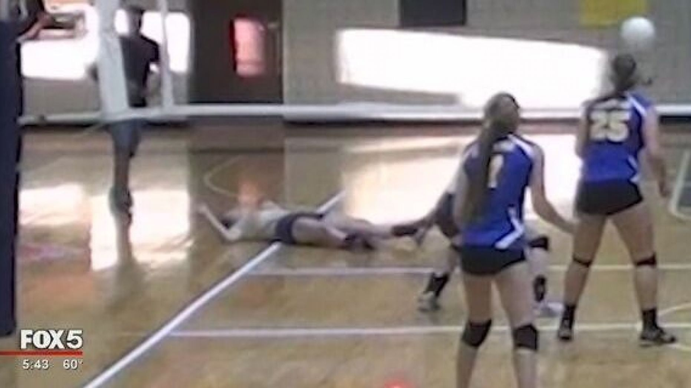
What does SCA look like?

Slide 29
Saving Our Kids –
One Heart at a Time
  1. Heart Screenings
  2. Cardiac Emergency Response Plans (CERP)

Slide 30
What are we missing?
Up to 90% of underlying heart issues are missed when using only the physical exam & family history
Most heart conditions that can lead to SCA are NOT detectable by listening to the heart with a stethoscope during a routine physical
Often, youth don’t report or recognize symptoms of a potential heart condition

Slide 31

Sports Physicals Are Failing Our Kids
Notes:
In spite of all of the advances in modern medicine….we are giving our kids the same physicals we received 20,30, 40 or more years ago.
We check our kids’ eyes and ears in school….what about their hearts?
Physical exam alone miss most heart issues that can lead to SCA

Slide 32
Youth Heart Screenings
Adding an Electrocardiogram to the pre-participation physical evaluation (PPE) will identify most heart conditions that can lead to SCA and prevent disabilities and sudden death in youth.

Slide 33
POLLING QUESTION

Slide 34
Youth Heart Screenings
An electrocardiogram (ECG / EKG) is a quick, painless noninvasive test that measures and records a moment in time of the heart’s electrical activity.
An EKG provides information about the structure, function rate and rhythm of the heart.

Slide 35
Why add an electrocardiogram?
An EKG can help to identify up to two-thirds of heart conditions that lead to SCA.
Notes:
Brendan O’Connor & JT Kuhn both had a detectable (and potentially treatable) undiagnosed heart condition – hypertrophic cardiomyopathy. Neither one of them ever received an electrocardiogram. Their parents desperately wish they had known to ask for one during well child visits and sports physicals.

Slide 36
Why Aren’t
We Checking Kids’ Hearts?
We check their eyes & ears….
…we make sure they have protective gear for sports…
…we check for hernias…
…and test for concussion symptoms…
..but we don’t check their hearts?

Slide 37
We have to do better.

Slide 38
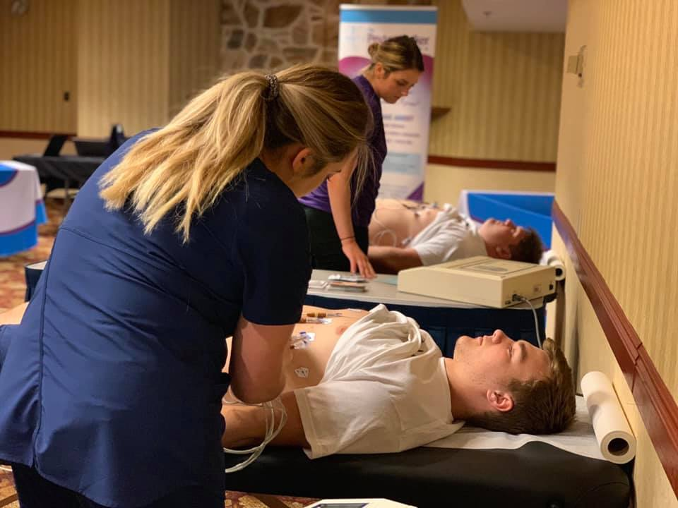


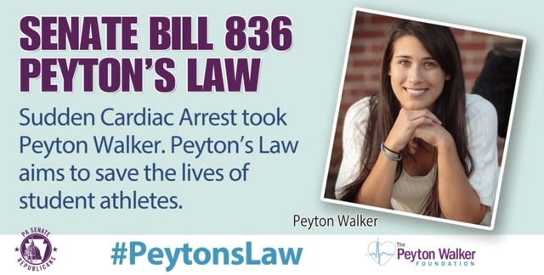
Peyton’s Law
Peyton’s Law
Cardiac Screening Legislation
Introduced August 2019
Signed into Law July 2020
Notes:
We decided…enough is enough. Someone had to stand up and fight for our kids. Texas passed Cody’s Law in 2019 – after 6 years of advocating and lobbying and 3 iterations of legislation. We knew we had to take a shot. We partnered with a passionate, well-connected Senator who took the lead on this legislation and made sure it got pushed through the PA Senate & House. PA became only the 2nd state in the country to pass this type of legislation.

Slide 39
Lifesaving Legislation
Using the Preparticipation Physical Evaluation (PPE) Form as an Information Tool for Parents & Students:
Include information about Sudden Cardiac Arrest
  Definition and review of signs/symptoms
  Risks of playing with symptoms
  Requires that students exhibiting symptoms be pulled from sports until cleared to return
Educate parents & students about the benefits of adding an electrocardiogram to sports physicals

Slide 40
Information is Power
Education can be lifesaving.
Families now know to ask for an EKG
An EKG is not mandatory – optional & paid for by the family
Covered by insurance when using the proper ICD-10 codes

Slide 41

Sweeping Across the US
Current & Pending Cardiac Screening Legislation
California
Indiana
Minnesota
North Carolina
New York
Ohio
South Carolina
Tennessee
Wisconsin
Passed In Texas and Pennsylvania

Slide 42
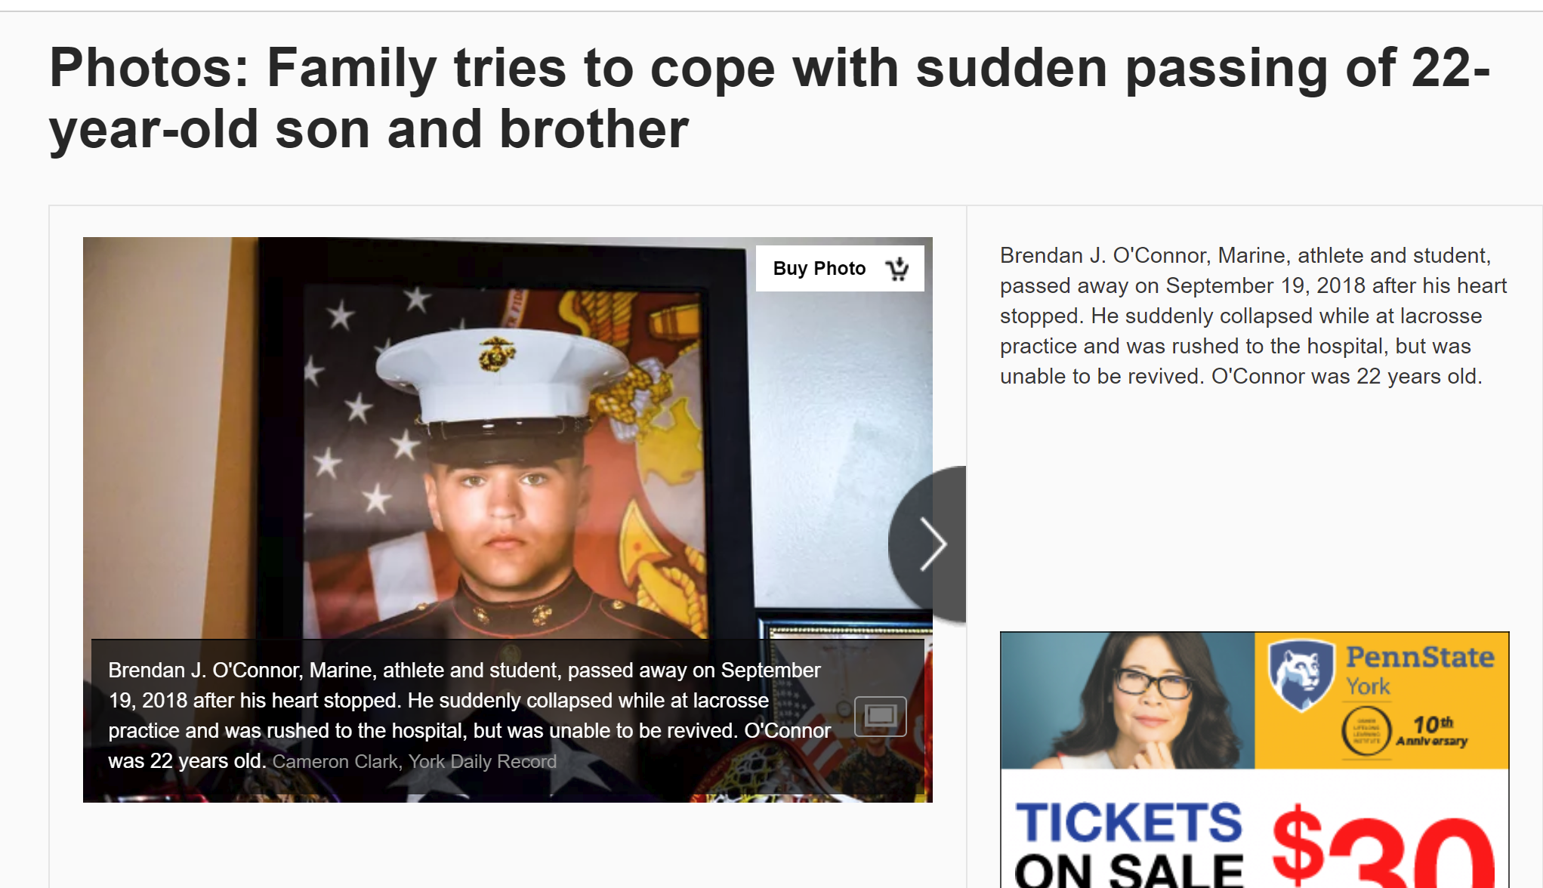
Why add an electrocardiogram?
“Had Brendan been tested, he would be with us today. He would be with us today…”
- Terry O’Connor, mother of 22-year old Brendan O’Connor who died of an undiagnosed heart condition while practicing lacrosse with his brother.
Notes:
Brendan O’Connor & JT Kuhn both had a detectable (and potentially treatable) undiagnosed heart condition – hypertrophic cardiomyopathy. Neither one of them ever received an electrocardiogram. Their parents desperately wish they had known to ask for one during well child visits and sports physicals.

Slide 43
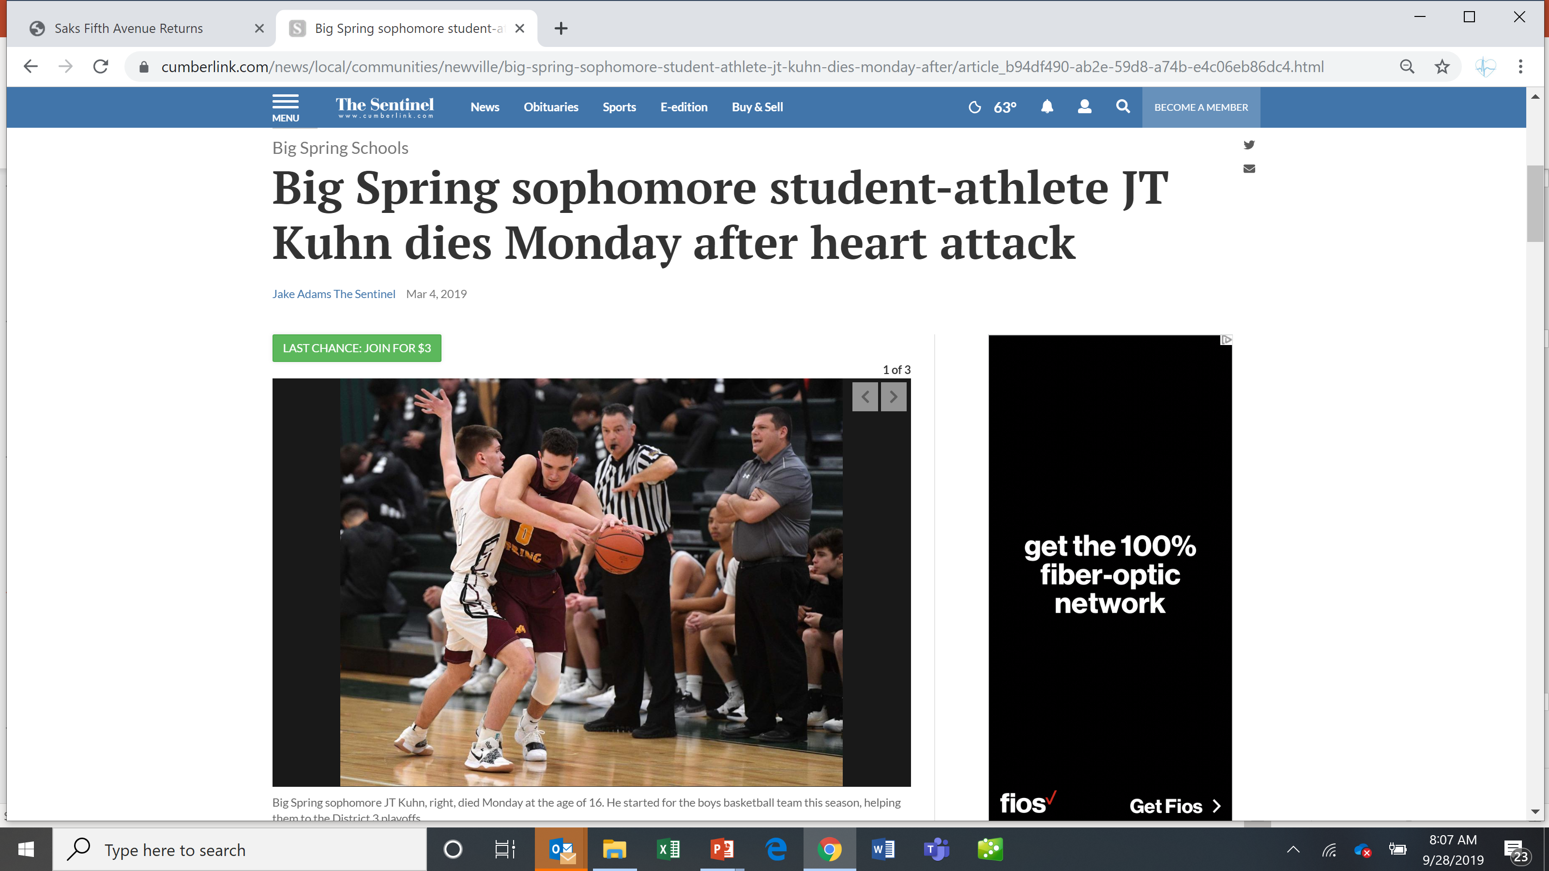
Why add an electrocardiogram?
“If we had him tested - JT might still be playing as a Bulldog as opposed to playing for Heaven’s basketball team.”
- Jennifer Kuhn, mother of JT, who died of an undiagnosed heart condition
Notes:
Brendan O’Connor & JT Kuhn both had a detectable (and potentially treatable) undiagnosed heart condition – hypertrophic cardiomyopathy. Neither one of them ever received an electrocardiogram. Their parents desperately wish they had known to ask for one during well child visits and sports physicals.

Slide 44
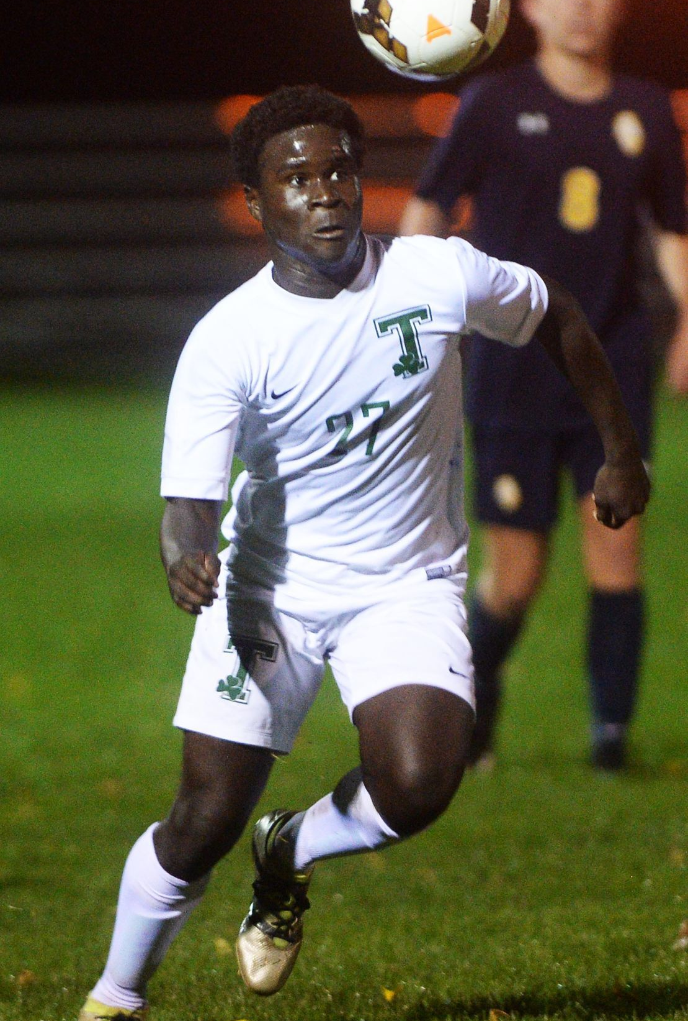
Wiz is
Why

Slide 45
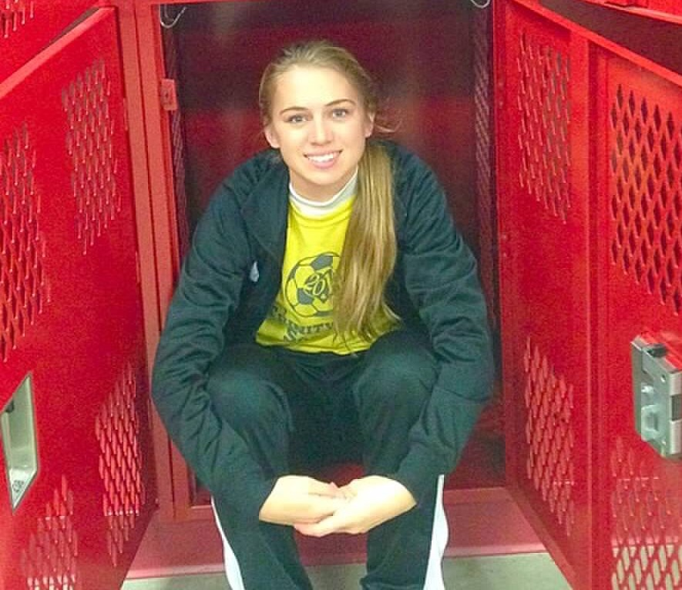
Sam is
Why

Slide 46
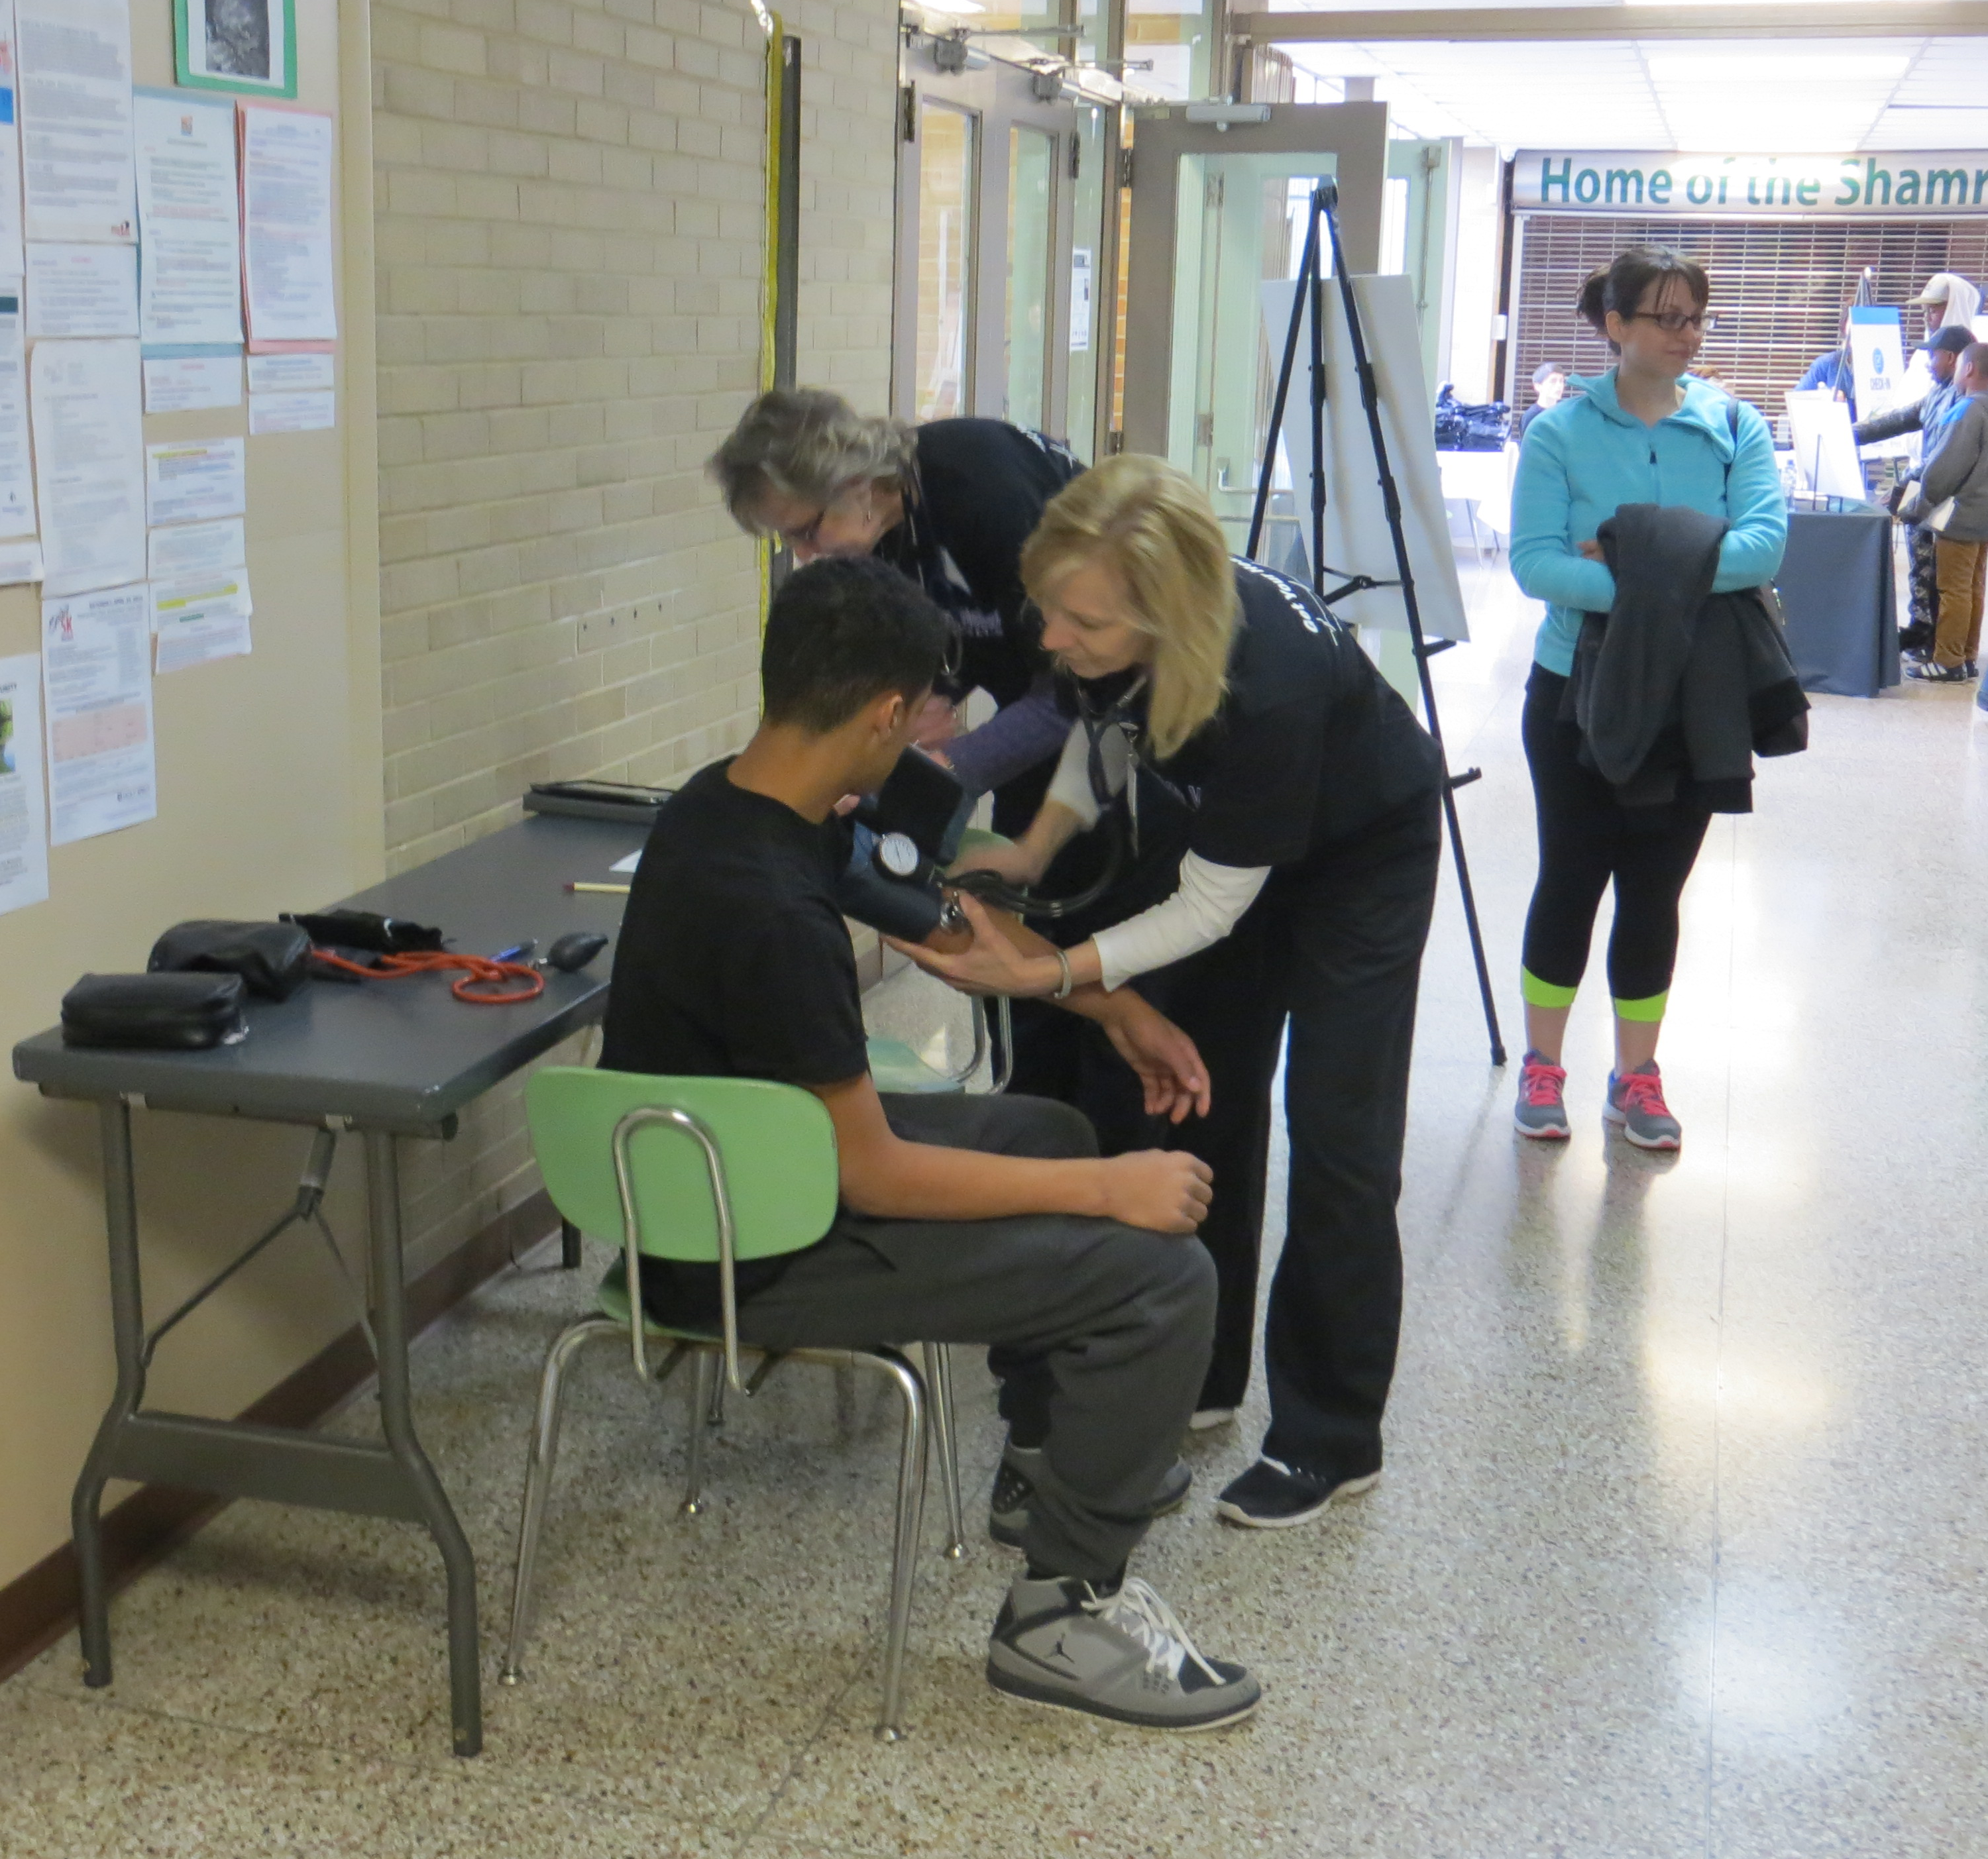
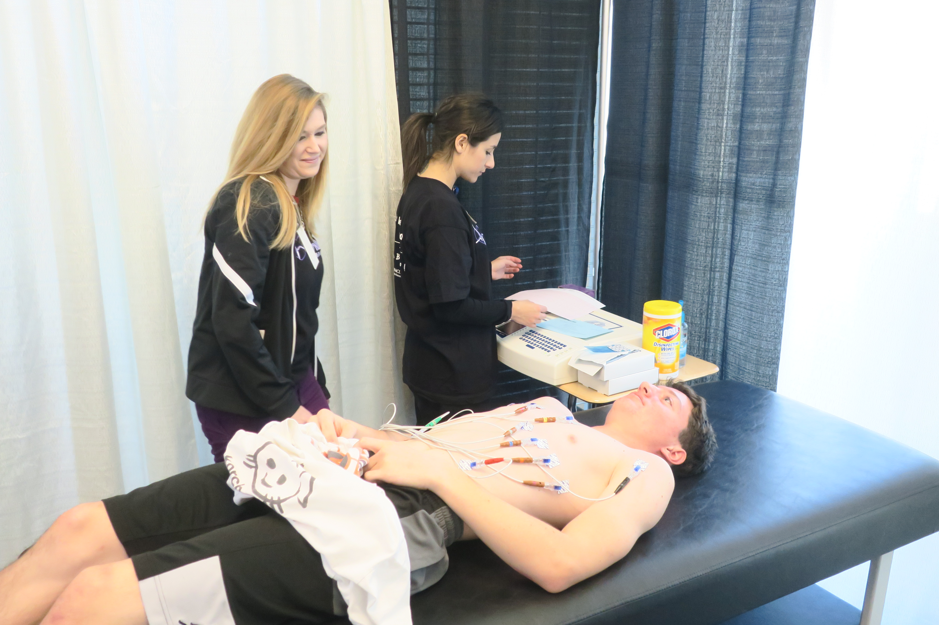
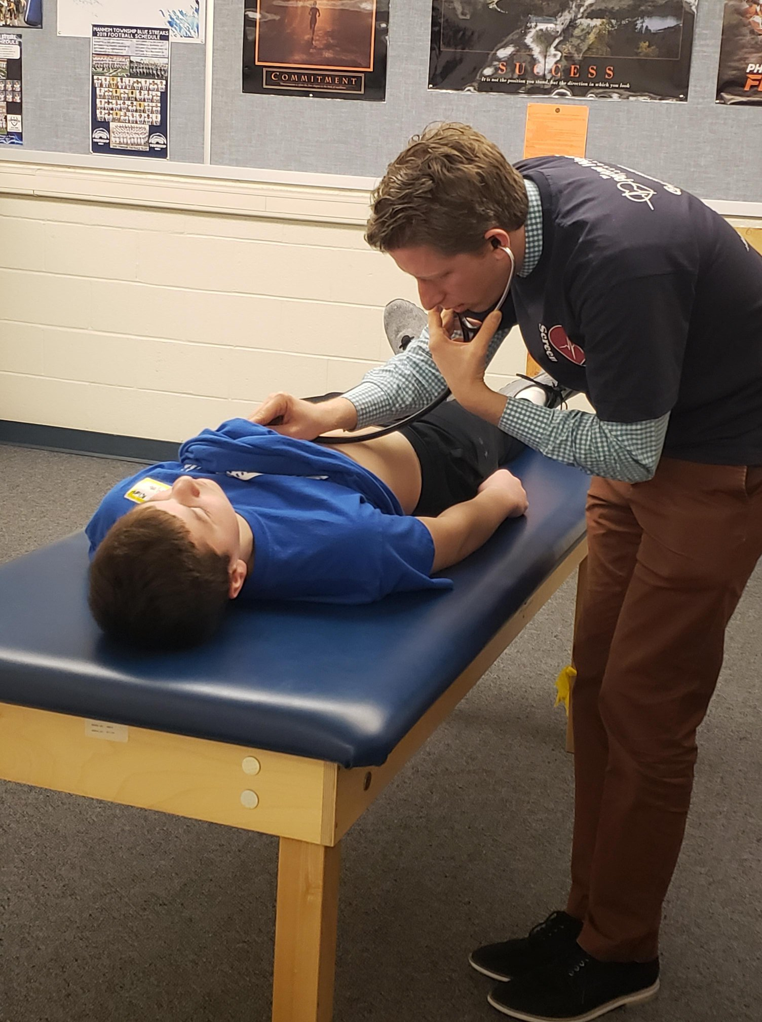
School Heart Screenings

Slide 47
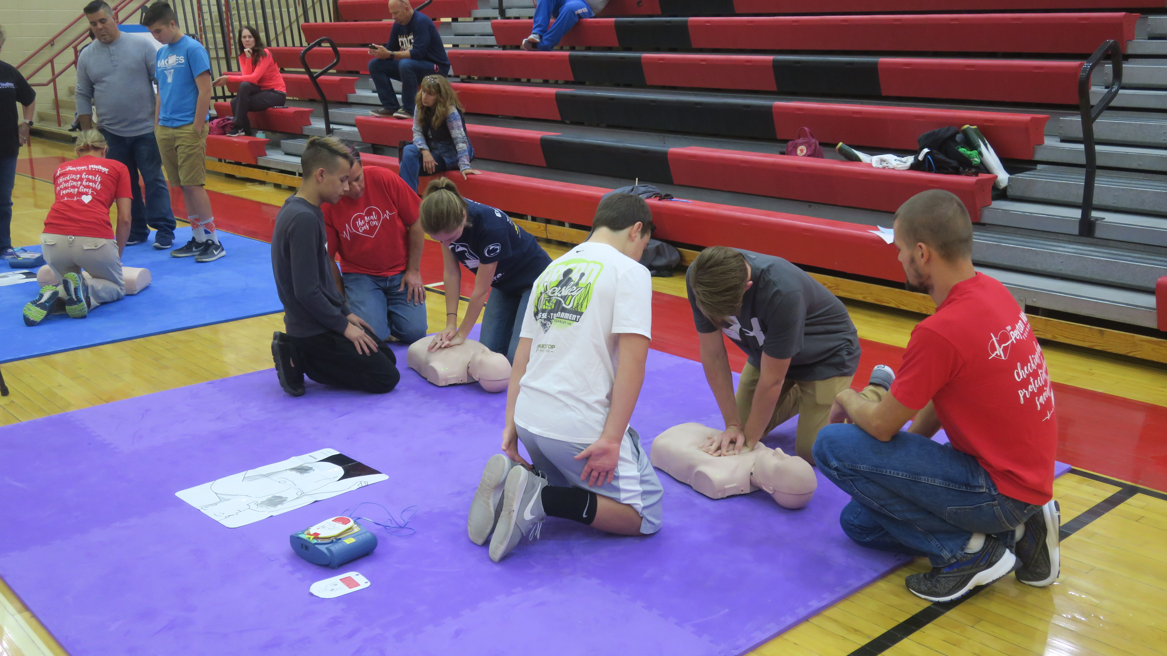
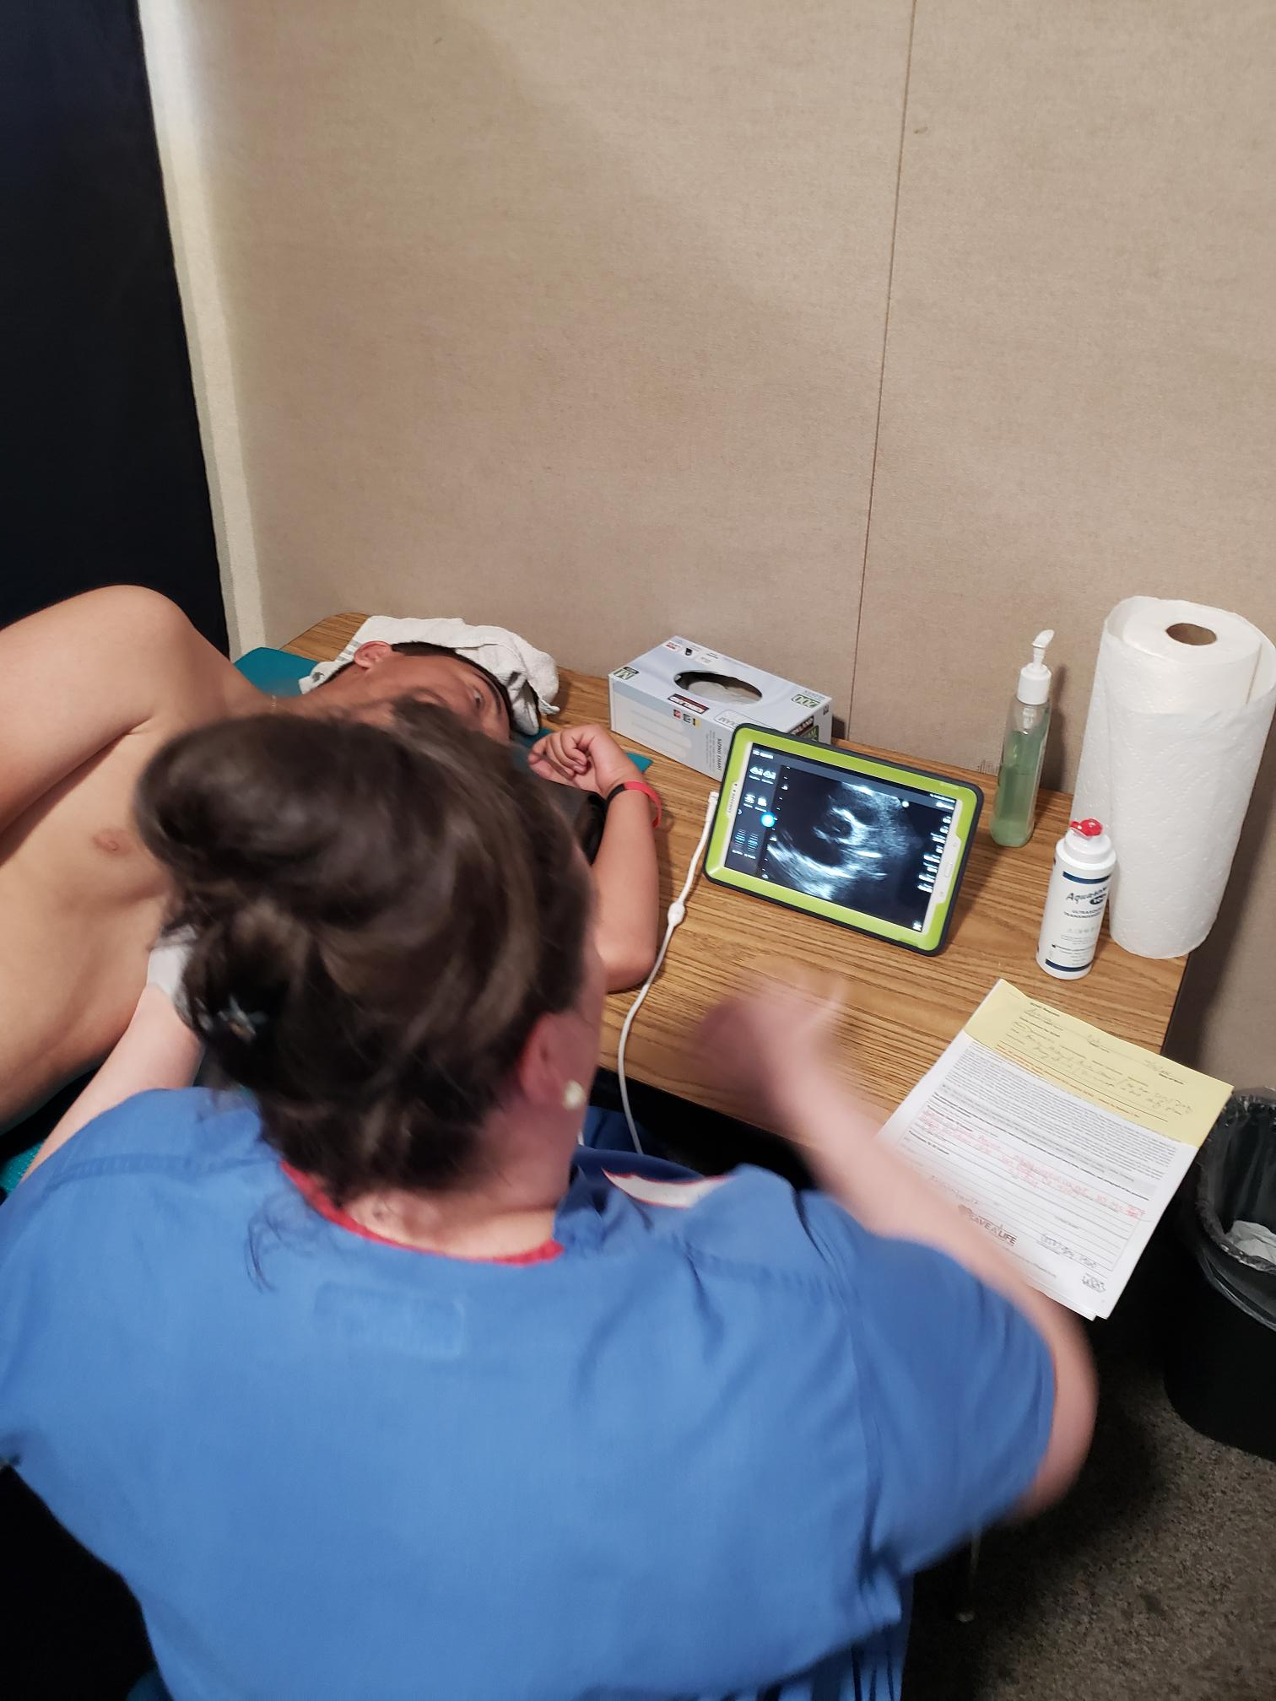
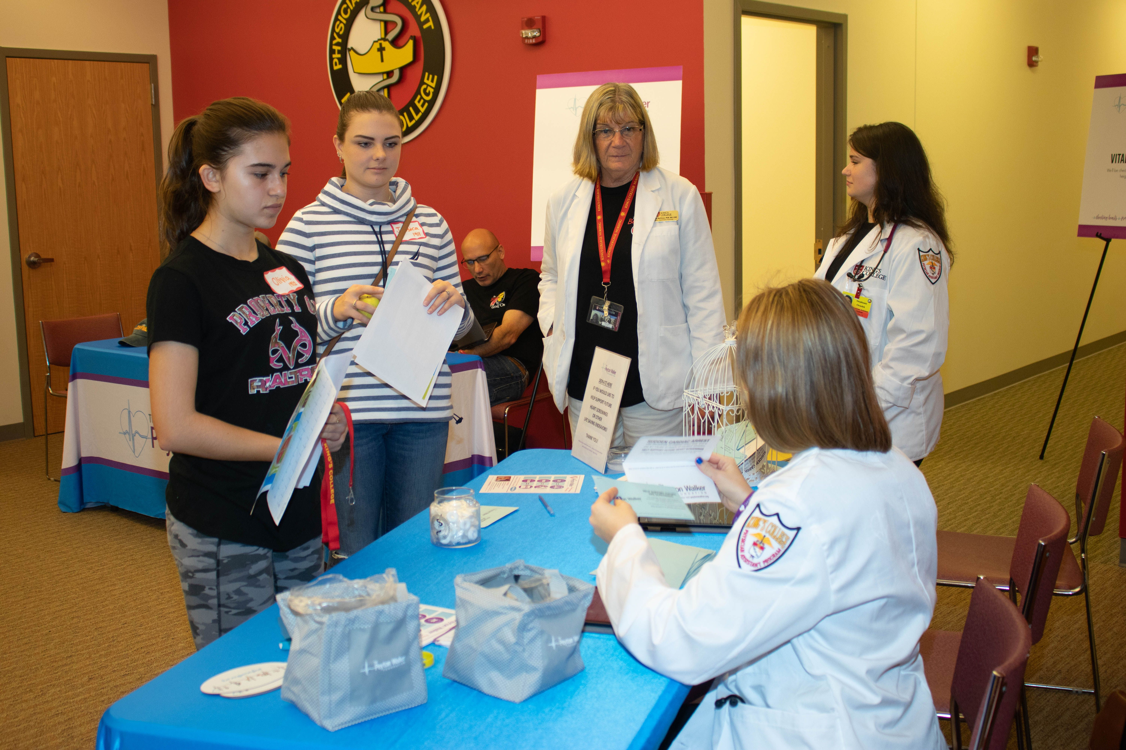
School Heart Screenings

Slide 48
Find a Youth Heart Screening Near You
Parent Heart Watch
  https://parentheartwatch.org/get-involved/find-a-heart-screening/
Notes:
Comprehensive list of youth heart screenings offered across the US. Many are hosted by nonprofit foundations similar to ours – people whose lives were impacted by SCA – either they lost a child or their child survived SCA.

Slide 49
Saving Our Kids –
One Heart at a Time
  1. Enhancing physicals to include Heart Screenings
  2. Cardiac Emergency Response Plans (CERP)

Slide 50
Do you have a Cardiac Emergency Response Plan in place at your school?

Slide 51
Let’s Go Back….
SCA is the leading cause of death
on school campuses.
Yet, many schools do NOT have a CERP in place and do not practice cardiac response drills.

Slide 52
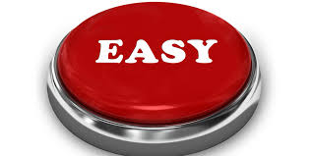
We’re going to give you some help!

Slide 53
CERP Components
Automated External Defibrillator (AED) Inventory / Assessment
Cardiac Emergency Response Team
Cardiac Emergency Response Plan
Training
Cardiac Emergency Response Drills

Slide 54
1) AED Assessment
The placement of the AED makes it accessible from any part of the building or campus within 2-3 minutes
AEDs have clear signage
The AED is checked for performance readiness monthly

Slide 55

AED Announcements At All Events:
“Ladies and Gentlemen….Sudden Cardiac Arrest is the leading killer of student-athletes in the US each year.
District III and The Peyton Walker Foundation have partnered to make Sudden Cardiac Arrest awareness a top priority again this year.
We ask your attention to the following:
In the event of a cardiac emergency, the nearest AED / Defibrillator is located at ______________________. (Schools fill in their location information)
Thank you for your attention to this important matter.”

Slide 56
2) Cardiac Emergency
Response Team
A CPR-AED site coordinator is identified who oversees the program and training
Assemble a team of 5-10 people (~10% of staff)

Slide 57
3) Cardiac Emergency
Response Plan
Create a written CERP plan that is reviewed annually
Develop an active crisis communication plan
Notify local EMS of your CPR/AED program
Share CERP plan with extracurricular activities, community groups, summer programs – anyone who uses the campus

Slide 58
4) Training
Organize and host CPR-AED training for the response team; refresh skills annually
Ensure all faculty and staff know where the AEDs are located and how to access them
Review warning signs, recognition and CERP with entire faculty annually

Slide 59
Does your school offer CPR & AED education and training for students?

Slide 60
5) Cardiac Emergency
Response Drills
Conduct at least one annual cardiac emergency response drill

Slide 61

…Because Claire’s school practiced response drills

Slide 62

CERP Resources
GOOD NEWS!!
You don’t have to create an entire plan on your own!
The work has already been done for you – just fill in the blanks.

Slide 63

None of their parents….

Slide 64
…ever thought IT would happen to their kid.

Slide 65
These Kids:
Look healthy
Act healthy
Are active
Beautiful
Smart
Fun
Kids

Slide 66
…And Sudden Cardiac Arrest
struck each one of them
without warning

Slide 67
Your Call To Action
Review signs/symptoms – can you recognize SCA?
Educate staff, faculty, coaches, parents & students about SCA
Advocate for heart screenings to help identify hidden heart issues that can lead to SCA
  Find Your 2%!

Slide 68
Your Call To Action
Make sure AEDs are accessible and rescue-ready
Implement AED announcements at school events
Create / manage a CERP for your school

Slide 69
Because…
You Don’t Ever Want to Make “The Call”

Slide 70
Resources Will Include:
Preventing SCA In Student Athletes – Informational Flyer
Pennsylvania PPE Form (with Peyton’s Law Language)
Link for SCA Video of Volleyball Player – Share & Scare!
Project ADAM Toolkit Link
Parent Heart Watch Link
Zeke Upshaw Link

Slide 71
SCA Straight Talk:
QUESTIONS?

Slide 72
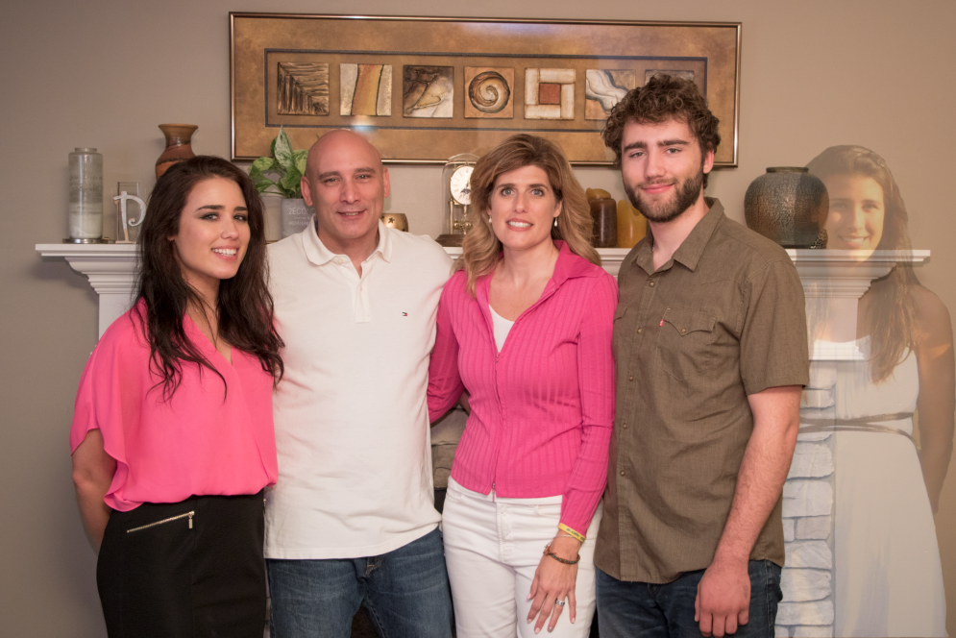


@PeytonWalkerfdn
@PeytonWalkerFoundation
PeytonWalker.org

