Slide 1
Meeting Students Where They Are: Trauma-informed Approaches in Post-pandemic Classrooms
Maria Frankland, Ph.D., NCC
August 12, 2020

Slide 2
Overview
What is trauma?
ACEs
What does it look like?
Manifestations of trauma
What can we do?
Stress response systems
Promoting resilience
Reframing our response
Distance learning

Slide 3
Trauma Defined
Individual trauma results from
an event, series of events, or set of circumstances that is
experienced by an individual as physically or emotionally harmful or life threatening
and that has lasting adverse effects on the individual’s functioning and mental, physical, social, emotional, or spiritual well-being.
https://www.samhsa.gov/trauma-violence

Slide 4
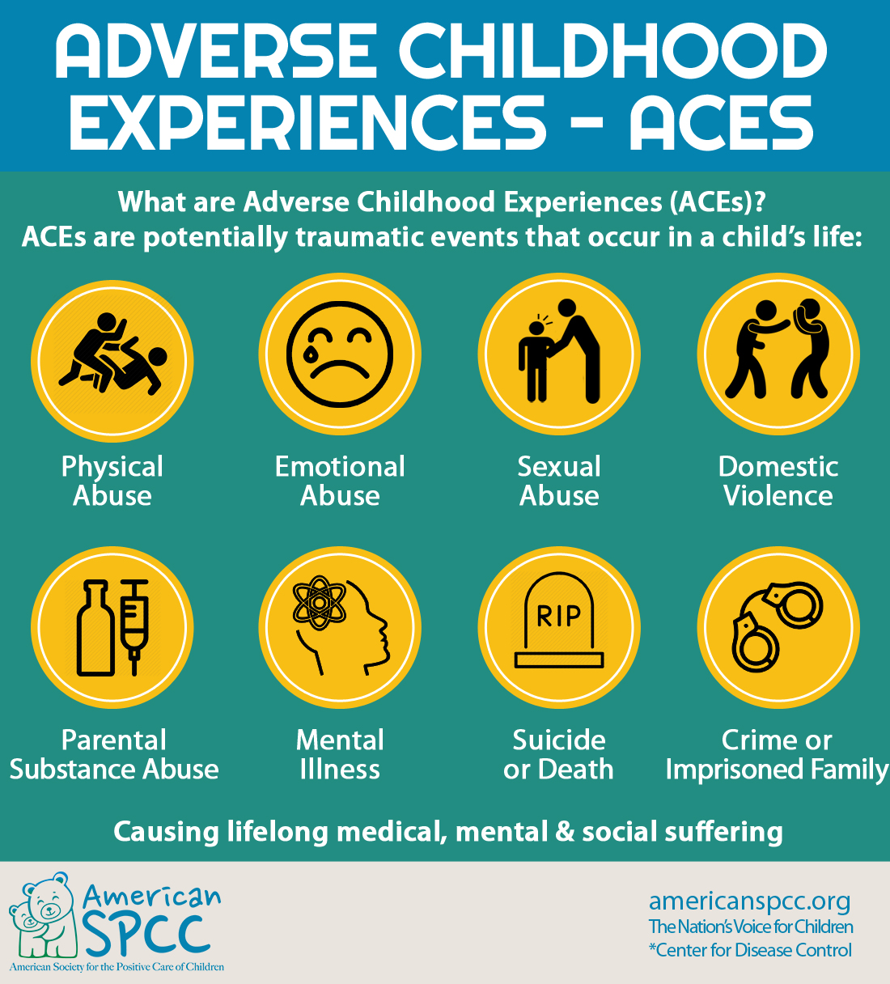

Slide 5
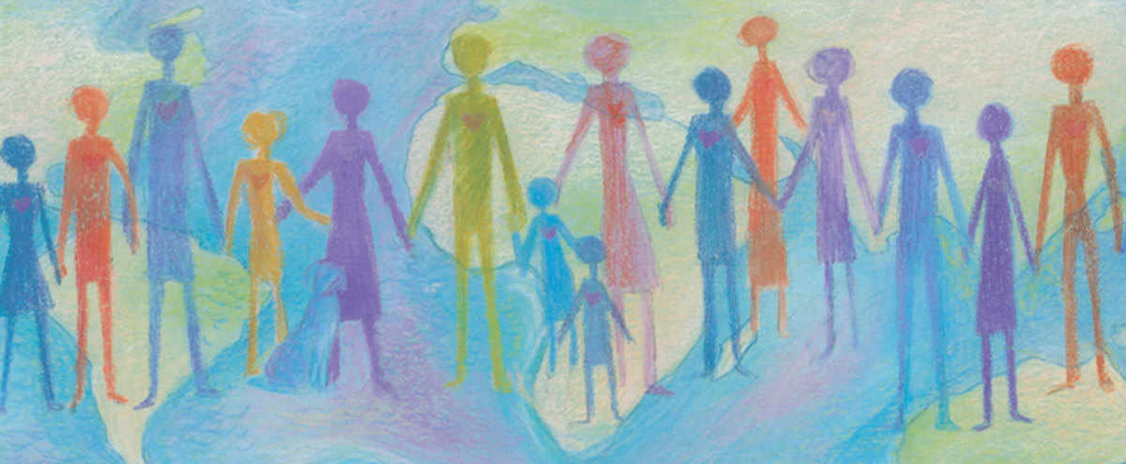
Collective Trauma
Traumatic experience that impacts entire groups of people, communities, or societies
Impacts:
relationships
policies and governmental processes
the way the society functions
social norms

Slide 6
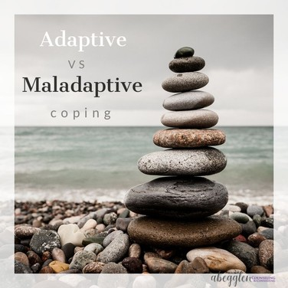

Slide 7
Maladaptive Responses: Internalizing Behaviors
Emotions are over-controlled
Directed inward
Somatic symptoms
What you may see
Sad, depressed, withdrawn, and/or fearful
Overly shy or timid
Reluctant to participate
Self-injury

Slide 8
Maladaptive Responses: Externalizing Behaviors
Emotions are under-controlled
Directed outward
More readily noticed
What you may see
Inappropriate language
Physical aggression
Noncompliance
Inappropriate use of technology

Slide 9
Why does this happen?

Slide 10
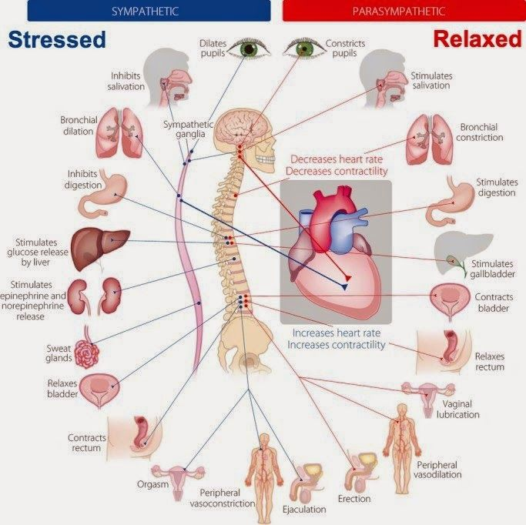
Physiology of the Stress Response
Nervous system
Faster and more specific
SLUDD vs fight-flight-freeze
Endocrine system
Slower and more diffuse
Epinephrine, norepinephrine, cortisol

Slide 11
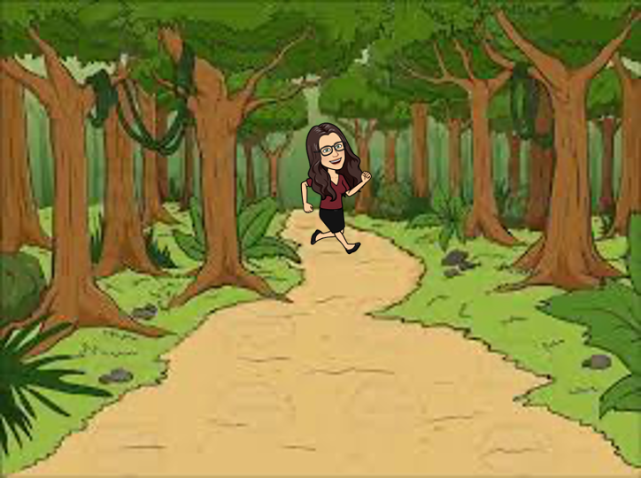

Slide 12
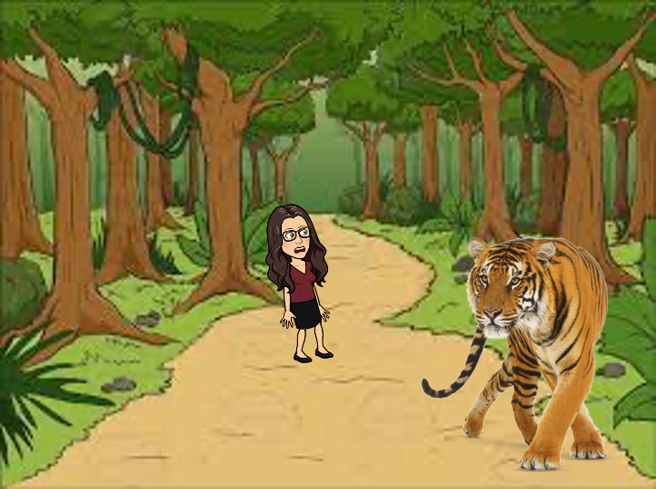

Slide 13
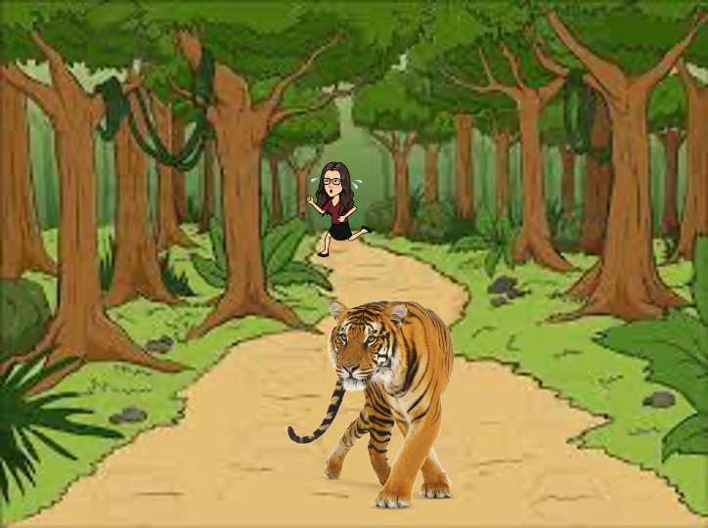

Slide 14
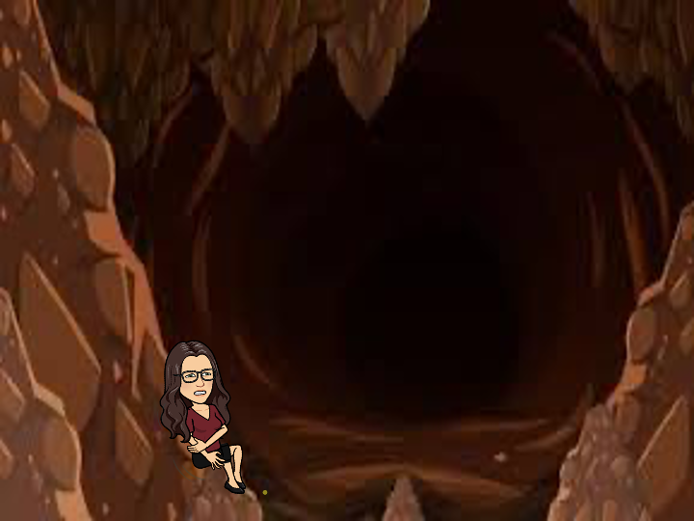

Slide 15
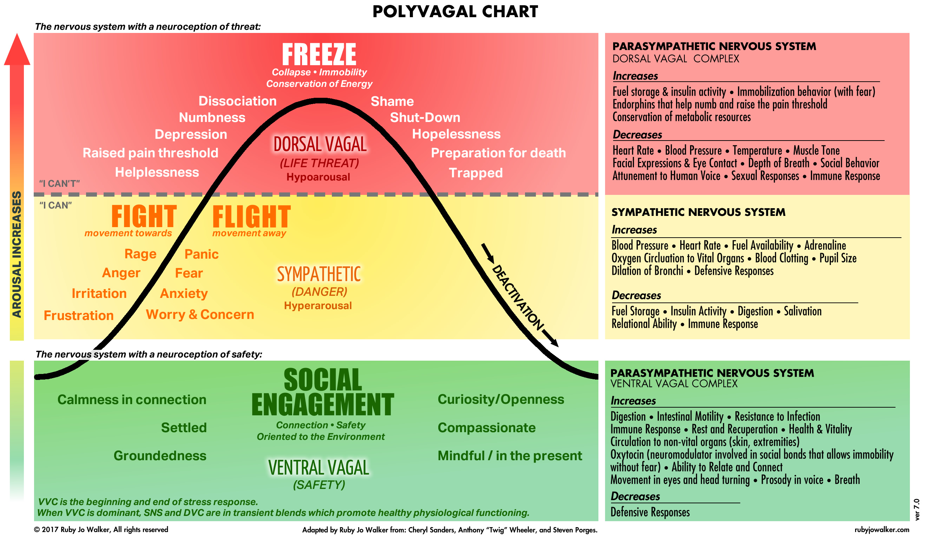

Slide 16
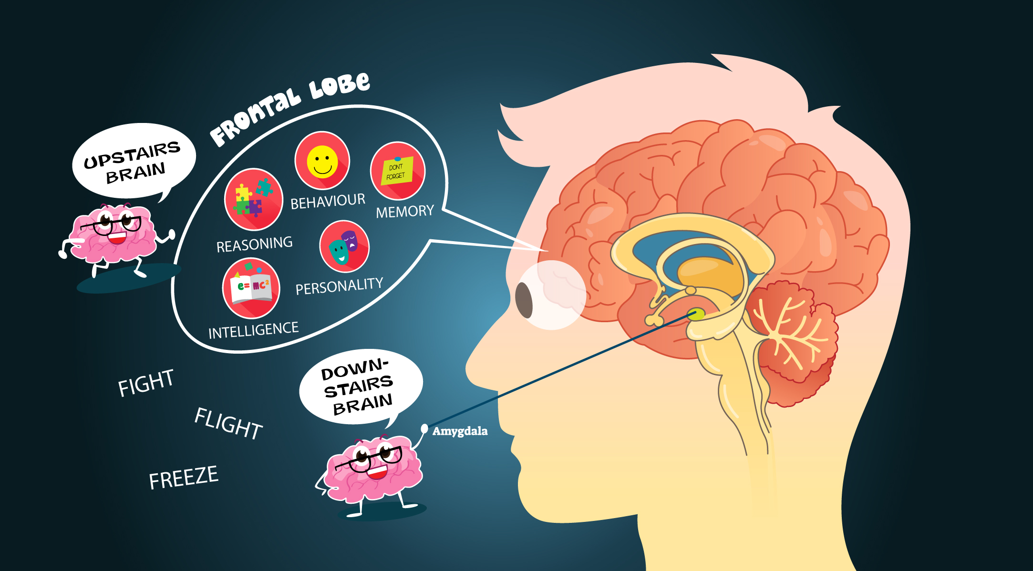
Which brain are you using?

Slide 17
How does this relate to school?

Slide 18
What’s wrong with you?

Slide 19
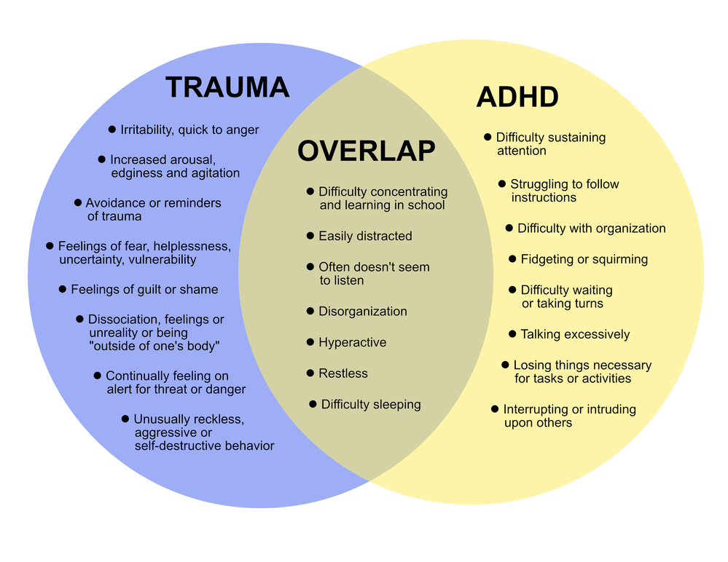

Slide 20
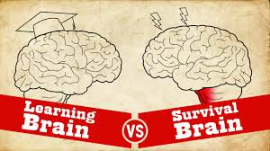
A Troubling Pattern
Special Ed referral
Chronic absenteeism
Increased risk of dropping out
Exclusionary discipline
Academic performance
Maladaptive behaviors

Slide 22
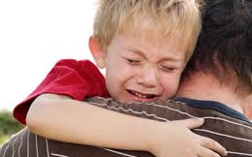
Separate the
DEED
from the
DOER

Slide 23
Trauma-informed: Key assumptions
Realization about trauma
Recognition of the signs and symptoms of trauma
Responses that incorporate knowledge of trauma
Resistance of re-traumatization
https://www.samhsa.gov/nctic/trauma‐interventions

Slide 24
Trauma-informed: Underlying Principles
Safety
Trustworthiness and transparency
Peer support
Collaboration and mutuality
Empowerment, voice, and choice
Cultural, historical, and gender issues
https://www.samhsa.gov/nctic/trauma‐interventions

Slide 25
What happened to you?

Slide 26
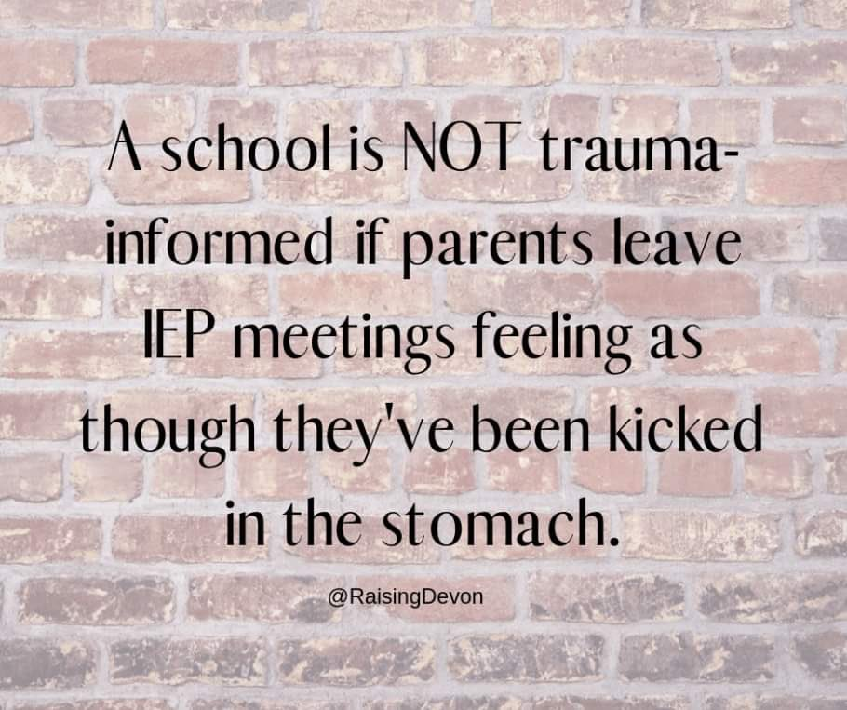
Trauma-informed IEPs
Reduce stress of the process for families
Consider the impact of trauma when conducting assessments
Lower readability levels of reports
Focus on the child, not the test
Goals and services focused on skill-building, improved relationships, and self-regulation
https://www.apa.org/pi/families/resources/newsletter/2018/11/trauma-teaching

Slide 27
Reframing Accommodations
Traditional | Trauma-Informed
Seating at the front of the class | I need a seat where I feel safe and secure
Repetition and explanation of directions | Access to sensory area or table in our classroom for patterned repetitive activities to help me calm down
Pre-printed classroom notes from teachers | A personalized set of my accommodations given to all who work with me to allow me to de-escalate, calm down, and become ready to work
Extended time on tests and quizzes | Extended time to regulate if I need this and academic modifications of my assignments when I am dysregulated
Goal: get better at asking for help when needed | Goal: lessen the number of times I need to use the resiliency team and reset area
http://revelationsineducation.com/publication-accommodations-through-an-aces-lens/

Slide 28
Impact of COVID-19
Sudden change of routine
Loss/change of relationships
Stress at home

Slide 29
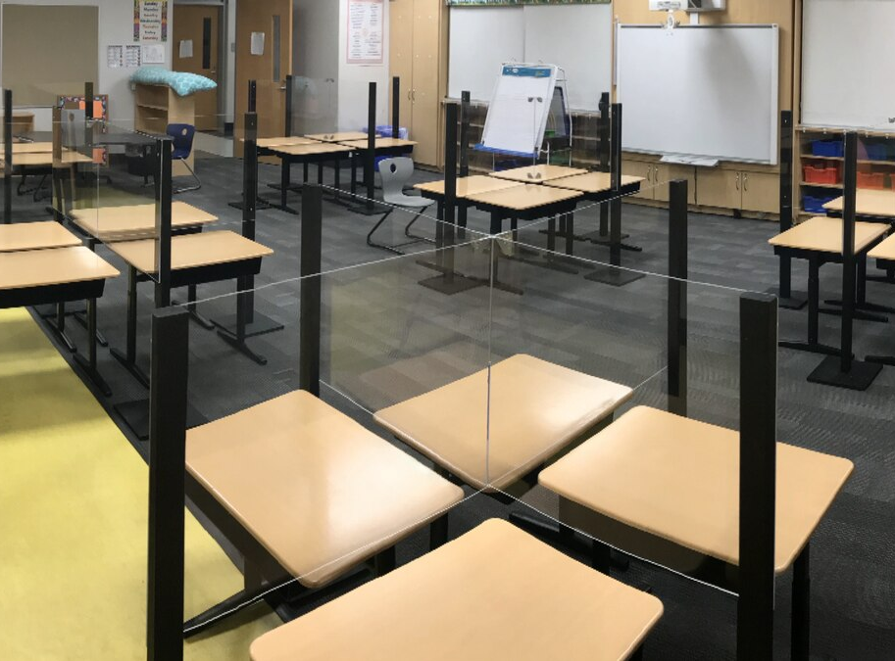
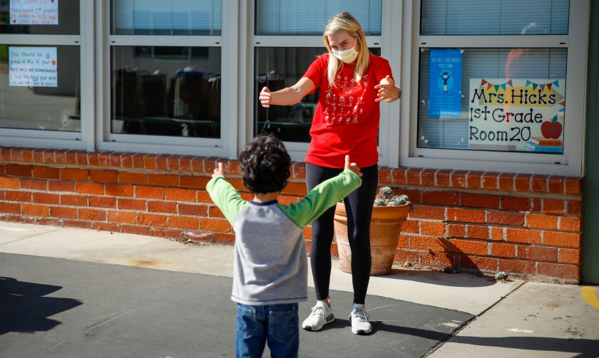
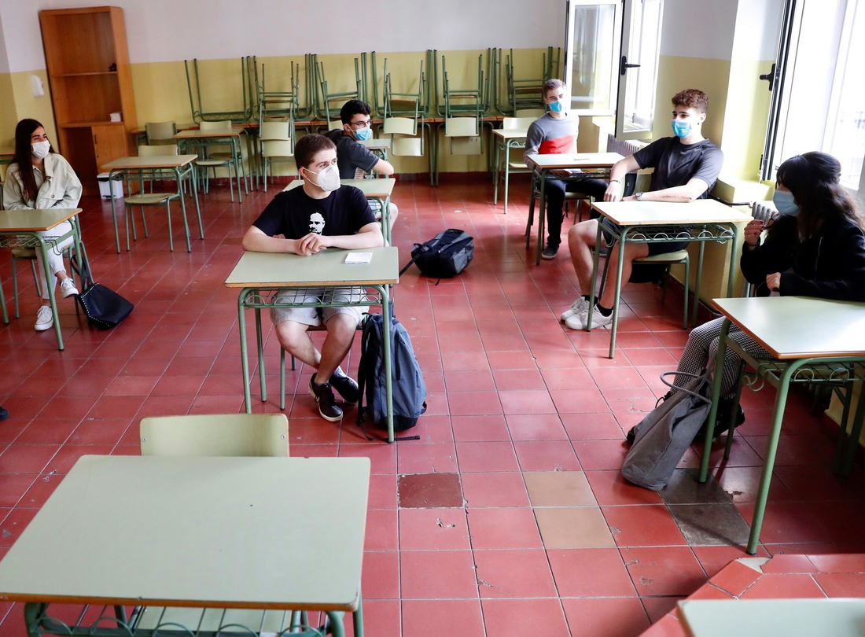
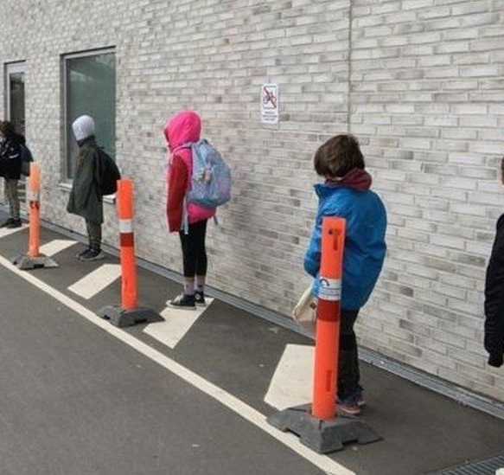
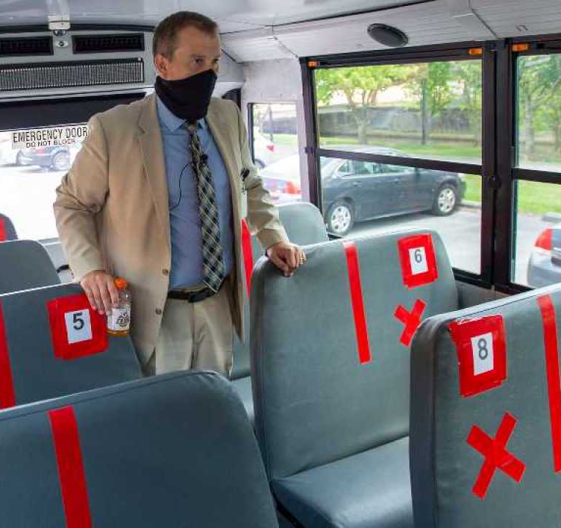
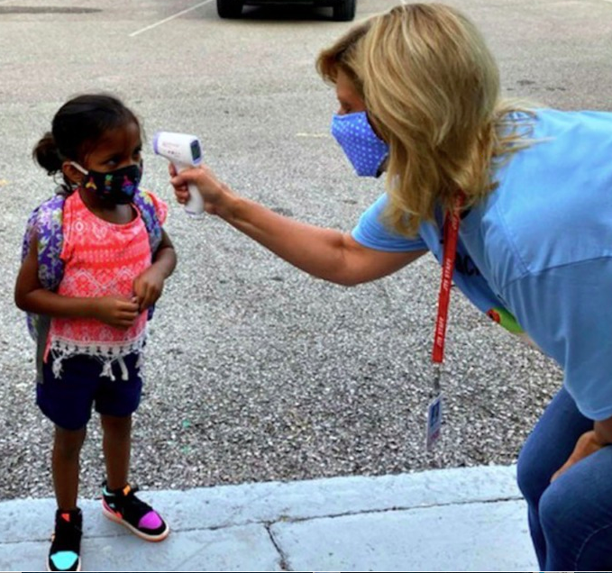

Slide 30
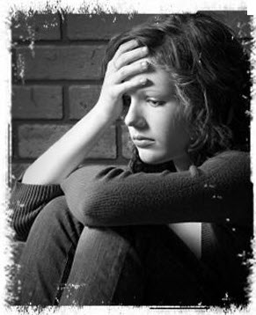
Re-traumatization
Reliving a trauma
Experiencing similar stress reactions
Reawakening memories of the initial trauma

Slide 31
Promoting Resilience
Develop caring relationships
Communicate high expectations and positive beliefs
Provide opportunities for student voice and choice

Slide 32
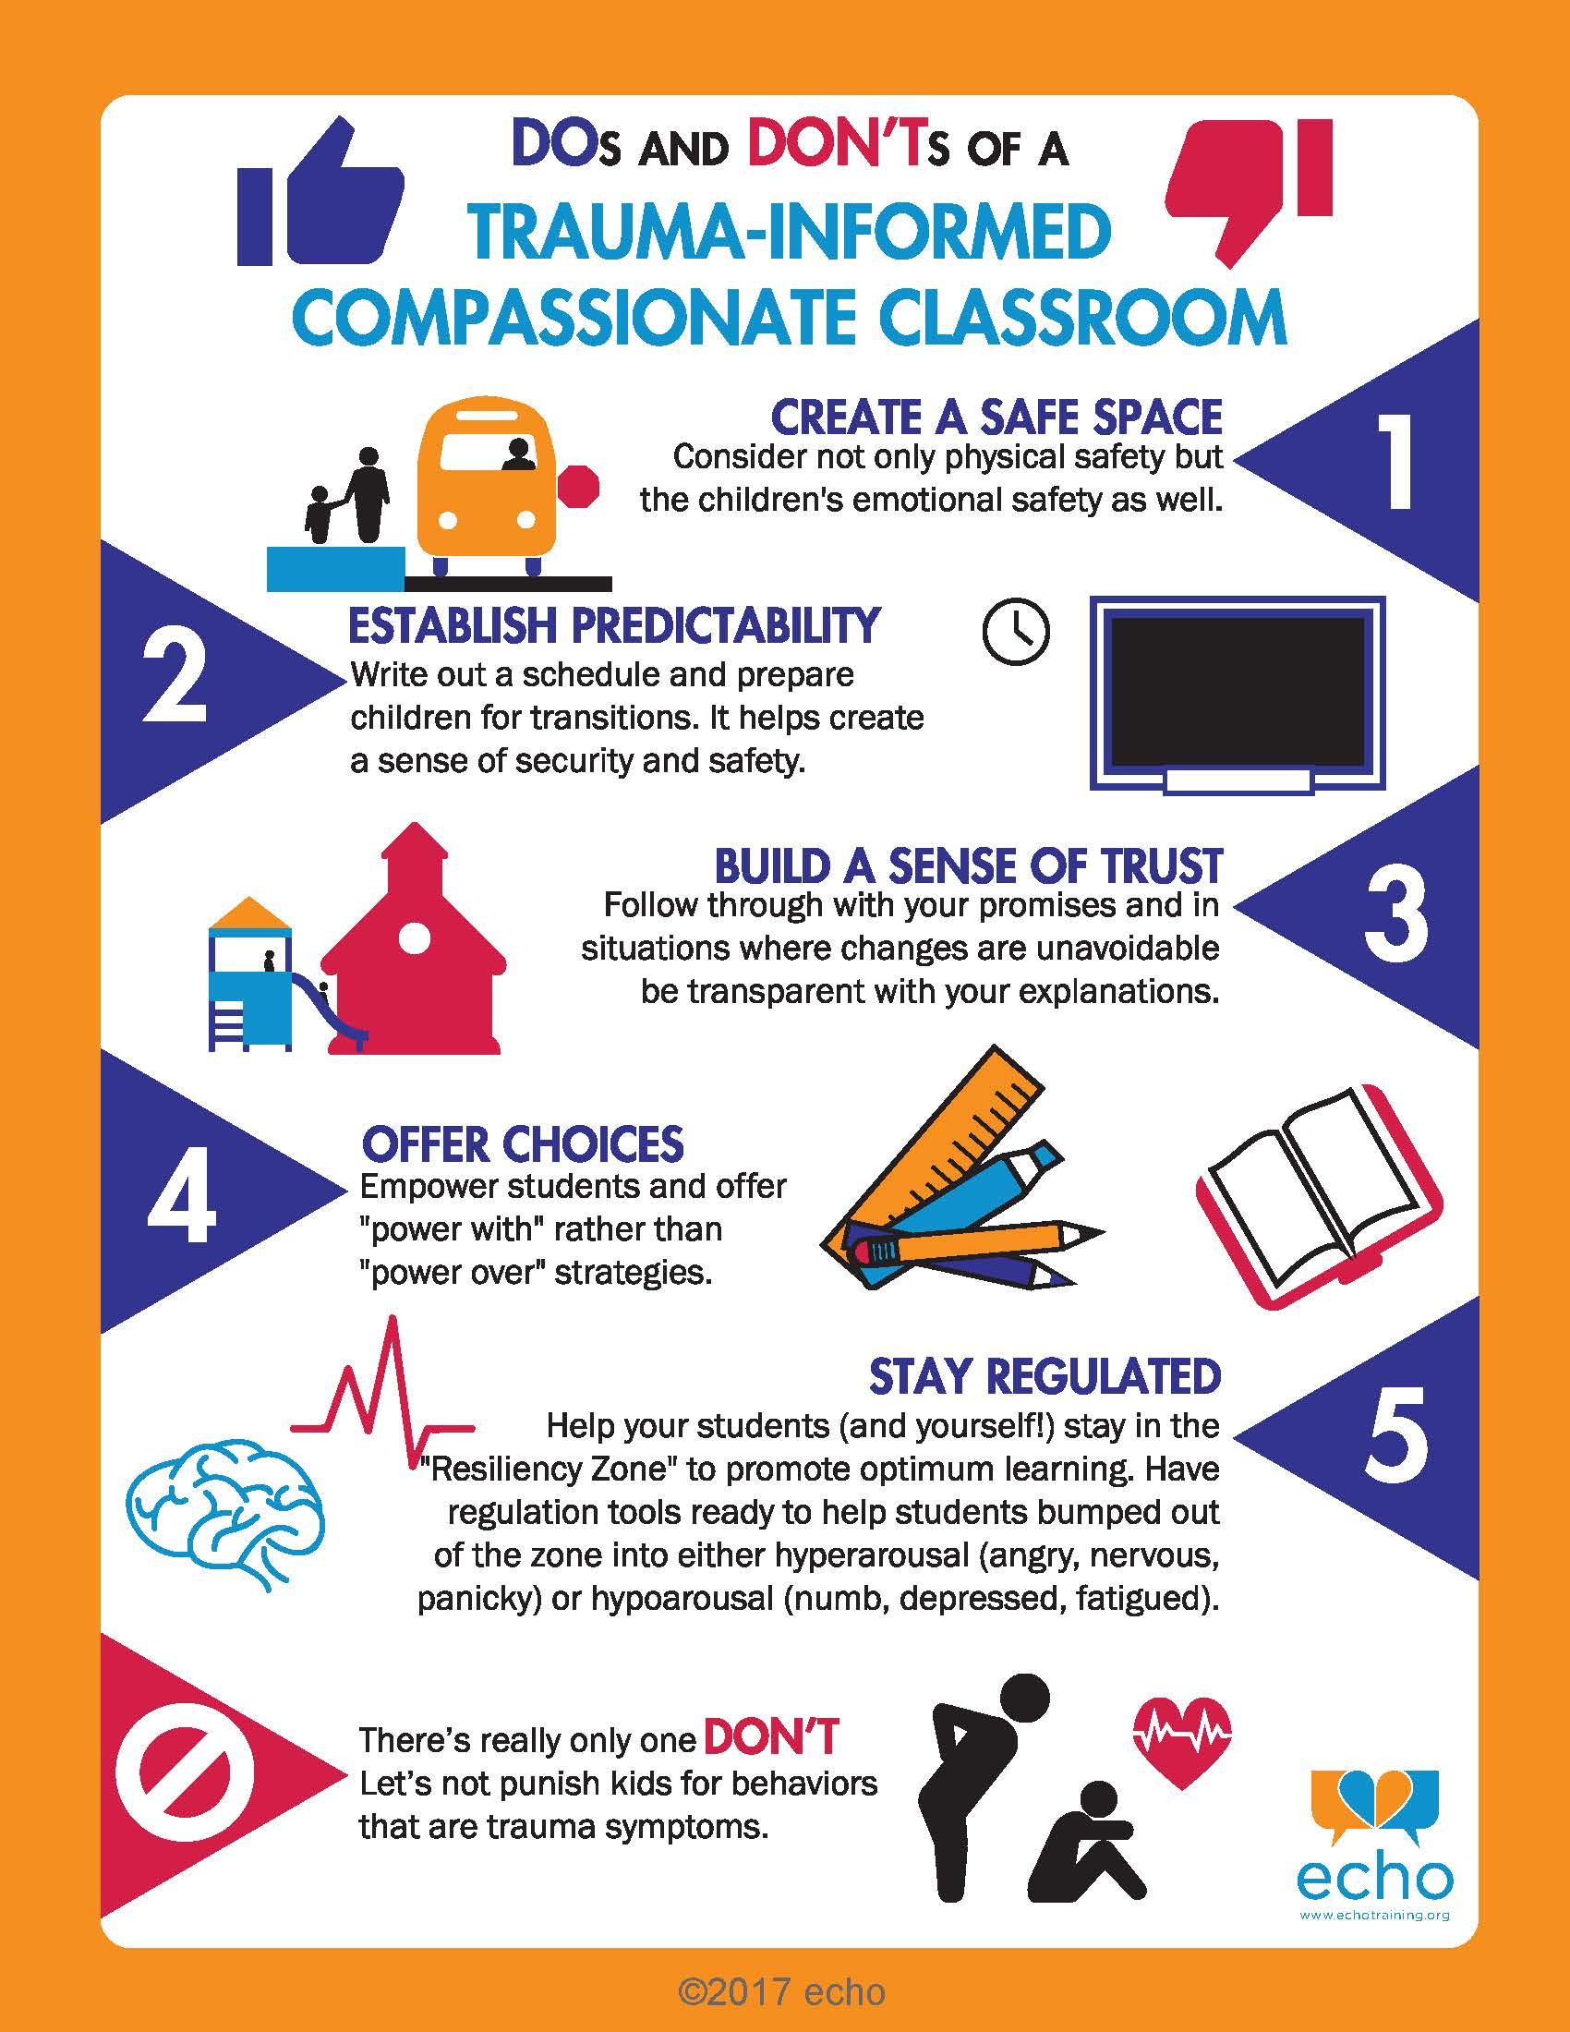

Slide 33
“Power With” Strategies
Care
Intentionality
Trust
Respect
Optimism

Slide 34
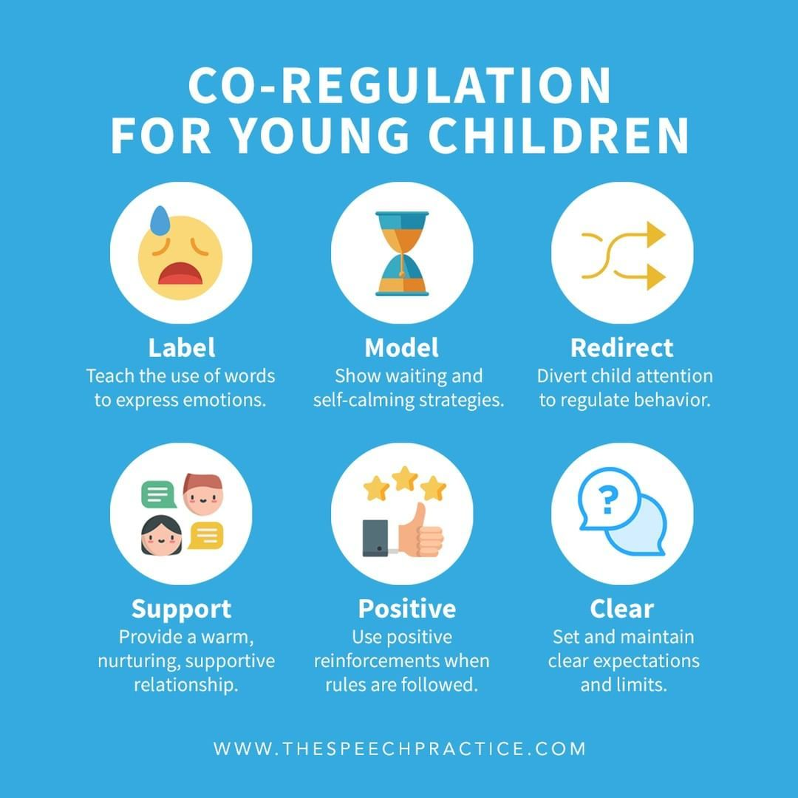

Slide 35
New Learning Paradigms
Hybrid – Remote – Online – Distance – Synchronous – Asynchronous
Stressful!
Be aware of potential inequities in:
Access
Support
Comfort

Slide 36
From Survival Brain to Learning Brain
Regulate
Relate
Reason

Slide 37
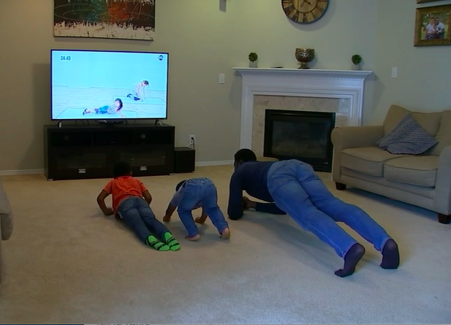
Step 1: Regulate
Students feel physically and emotionally calm and settled.
Create structure through routine
Provide opportunities for student input
Insert breaks for self-regulation and physical activity

Slide 39
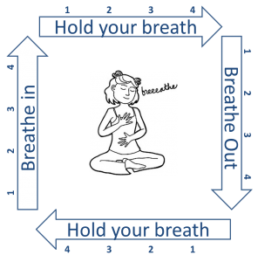
Square Breathing

Slide 40
Activities
Go for a walk | Take a virtual tour of a museum, aquarium, or zoo | Clean and organize a drawer or closet | Play a board game
Give yourself or someone else a makeover | Read a book or listen to an audiobook | Do a jigsaw puzzle | Go on a photo scavenger hunt
Create a playlist | Rearrange your bedroom | Make a collage | Cook or bake
https://umaine.edu/beyond-crisis-schooling/

Slide 41
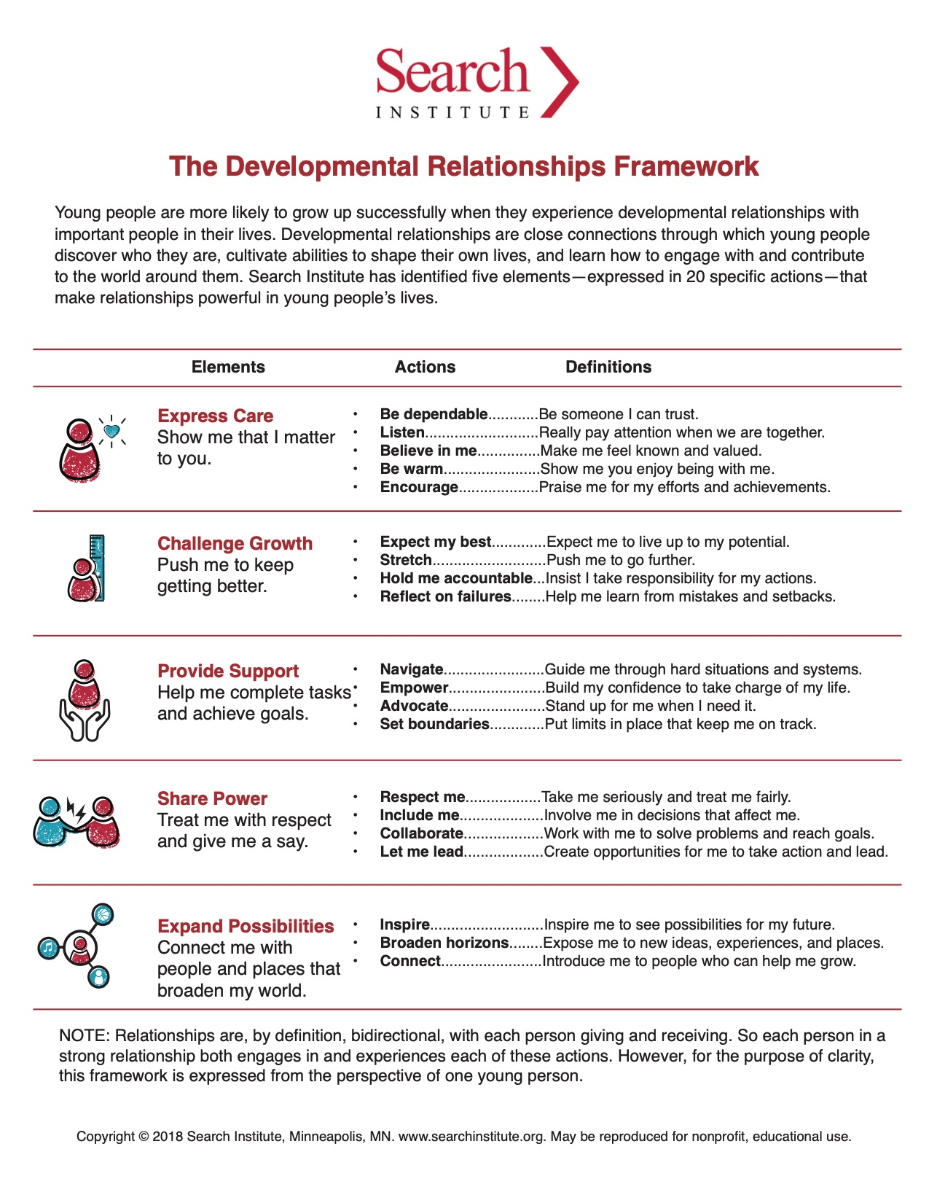
Step 2: Relate
Students feel emotionally connected through safe and supportive relationships attuned to their needs.
Reframe challenging behaviors
Respond, don’t react
Model positive interactions
Create ways for students and families to check in

Slide 42
Step 3: Reason
Students feel ready and able to engage with formal instruction and learning.
Trial and error are inevitable
Reduce workloads and chunk assignments
Use both verbal and written instructions
Connect learning with household activities

Slide 43
Tips for Caregivers
Make time for yourself
Prioritize healthy choices
Be realistic
Set boundaries
Reconnect with things you enjoy

Slide 44
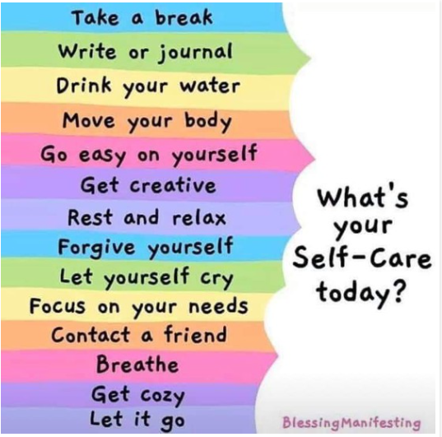

Slide 46
Email: maria.frankland@maine.edu
Twitter: @maria_frankland

